Slide 1
Legal Practicalities of Accommodating Individuals with Disabilities within Healthcare Settings
Chatón T. Turner, Esq.

Slide 2
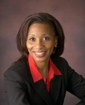
Who Am I?
Chatón T. Turner, Esq.
  Employer: Senior Associate Counsel and Vice President Risk Management and Disabilities Services UPMC | University of Pittsburgh Medical Center
  Hometown: Originally from Rochester, New York; Have lived in Pittsburgh for a number of years
  Education: Graduate of The University of Virginia and The University of South Carolina School of Law
  Hobbies: Running, Reading, Communicating, Hanging out with my kids
Notes:
Image from http://hoosonline.virginia.edu/atf/cf/%7B70FAD66E-5F73-4C66-8853-9FDE107C1B85%7D/Chaton-Turner.gif

Slide 3
Objectives
This presentation will discuss the requirements that health care facilities must satisfy to comply with applicable civil rights laws intended to ensure that people with disabilities enjoy equal access to their services. There will be practical examples as applied in one of the leading integrated delivery and financing systems in the country.
Discuss the barriers faced by people with disabilities (including ineffective communication) in accessing effective health care that may or may not be associated with their disabilities.
Learn how health care facilities can provide people with disabilities with equitable access to appropriate, accessible, and high-quality health care.
Explain why training should be provided to all health care providers so that they are able to provide high-quality care to patients with disabilities.
Identify ways that healthcare providers can maximize the quality of life of their patients with disabilities by preventing and treating health conditions.
Discuss why providing persons with equal access to healthcare and complying with disability related laws is a prudent risk management measure.
Notes:
Image from http://hoosonline.virginia.edu/atf/cf/%7B70FAD66E-5F73-4C66-8853-9FDE107C1B85%7D/Chaton-Turner.gif

Slide 4

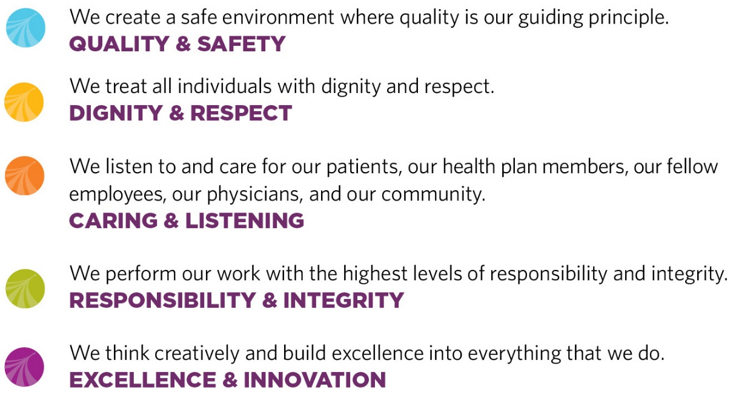
Notes:
Talking point: Introduce the UPMC values and create appropriate links and example of BU existing values, where appropriate.

Slide 5

Meeting the Need:
Patients with Disabilities in Healthcare
Physical Disabilities
Blind or Low Vision
Deaf, Deaf-Blind, or Hard of Hearing
Intellectual and Cognitive Disabilities
Speech Impairment
Behavioral Health
Autism
Notes:
Situations where an interpreter may be needed
Discussing a patients symptoms and medical condition, medications, and medical history
Explaining and describing medical conditions, tests, treatment options, medications, surgery and other procedures
Providing a diagnosis, prognosis is, and recommendation for treatment
Obtaining informed consent for treatment
Communicating with a patient during treatment, testing procedures and during physician’s rounds
Providing instructions for medications, post treatment activities, and follow up
Providing mental health services, I
Providing info about blood or organ donations
Explaining living wills and powers of attorney
Discussing complex billing or insurance matters
Making educational presentation, such as birthing and new parent classes
Family members or guests

Slide 6

Laws, Regulations, and Standards
Guiding Our Work
Americans with Disabilities Act (ADA) 1990, as amended 2010
ADA Amendment Act (ADAAA) 2009
Section 504 of Rehabilitation Act 1973
Act 1557 of the Affordable Care Act
International, State and Local Building Codes
Joint Commission
US Access Board Standards

Slide 7
Obligations for Healthcare Providers
The Americans with Disabilities Act (ADA) is a Civil Rights Law.
  Title III of the Americans with Disabilities Act prohibits the discrimination of an individual on the basis of a disability in any place of public accommodations - including hospitals and offices.
The purpose of the ADA is to ensure that patients, visitors, and guests with disabilities can fully and equally access and enjoy the goods, services, and facilities of the hospital without being segregated.
Section 504 of the Rehabilitation Act is a federal civil rights statute that prohibits discrimination and/or harassment on the basis of a disability.
  Federal Law Requires Accommodation: UPMC is obligated to provide reasonable accommodations to everyone who has a disability whether it is an employee, patient, visitor, or guest.
Any complaint related to a disability must be reported to your Section 504 Coordinator and the grievance process followed.
Section 1557 is the civil rights provision of the Affordable Care Act of 2010: Ensuring Effective Communication with and Accessibility for Individuals with Disabilities.

Slide 8

What are the Accessibility Issues for Patients with Disabilities in Healthcare?
Physical Access and Equipment
Patient Transfer
Effective Communication
Parking
Service Animals
Alternative Format Documents
Kiosks and Web Accessibility
Staff Training and Awareness
Notes:
Situations where an interpreter may be needed
Discussing a patients symptoms and medical condition, medications, and medical history
Explaining and describing medical conditions, tests, treatment options, medications, surgery and other procedures
Providing a diagnosis, prognosis is, and recommendation for treatment
Obtaining informed consent for treatment
Communicating with a patient during treatment, testing procedures and during physician’s rounds
Providing instructions for medications, post treatment activities, and follow up
Providing mental health services, I
Providing info about blood or organ donations
Explaining living wills and powers of attorney
Discussing complex billing or insurance matters
Making educational presentation, such as birthing and new parent classes
Family members or guests

Slide 9
Policies & Procedures, Examples from UPMC
UPMC policies include people with disabilities and address unique needs:
Patient Rights
Patient Non-Discrimination
Communication Assistance, Inpatient
Communication Assistance, Outpatient
Service Animals
Patient Room Assignment
Section 504 Grievance Procedure

Slide 10
Education and Training
Topics:
  Disability Awareness Training
  Effective Communication for Individuals who are Deaf, Deaf-Blind, or Hard of Hearing
  Service Animal Panel Video
  ADA Maintenance Training
  Breast Screening for Individuals with IDD
  Assistive Listening Toolkit Videos
  Customized Trainings

Slide 11

Facility Accessibility: Equal Access

Slide 12
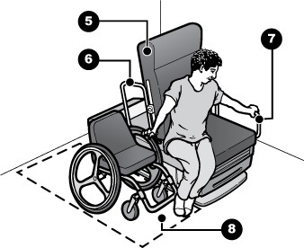
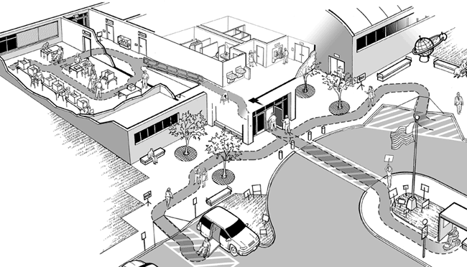
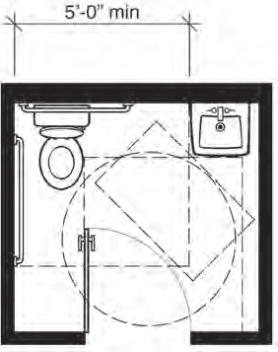
Facility Accessibility: Equal Access
Facilities Review Committee
Focus:
  Acute Inpatient Rooms
  Public Restrooms
  Outpatient Facilities
  Entrances and Accessible Routes
  Parking
  Medical Equipment
Construction Plan Reviews
  New construction and larger renovation projects
Accessibility Checklists

Slide 13
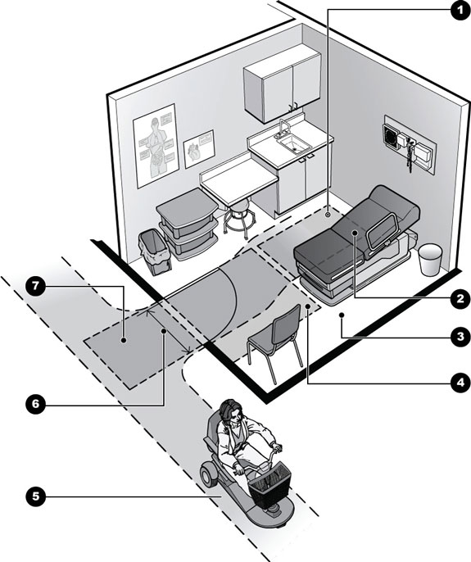
Facility Accessibility: Equal Access
A “Barrier-free”
medical appointment for patients with physical disabilities
Accessible route and clear floor space next to the exam table so a patient can safely transfer
Maneuvering clearances at the doorway to get into the room
Adjustable height exam table
Enough space between table and wall to allow staff assistance for transfers and positioning
Accessible entry doorway- 32” clear opening width with door open 90 degrees
Floor space next to and at end of exam table or equipment depending on how patients transfer
Accessible route to other accessible public and common use spaces such as bathrooms, reception, and registration areas

Slide 14
US Access Board Standards for Accessible Medical Diagnostic Equipment
Issued in the Federal Register on January 9, 2017
Design criteria for examination tables and chairs, weight scales, radiological equipment, mammography equipment, and other equipment used for diagnostic purposes by health professionals:
https://www.access-board.gov/guidelines-and-standards/health-care/about-this-rulemaking/final-standards

Slide 15
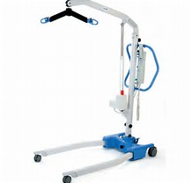
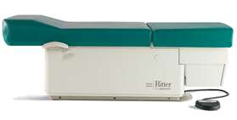
Resources for Accessible Health Care:
Physical Disabilities/Mobility Impairments
Barrier Free
High-Low Exam Table
Patient Lift

Slide 16
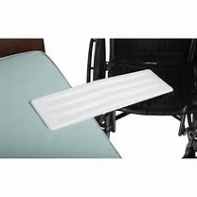
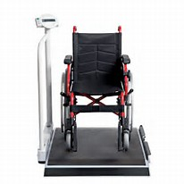
Resources for Accessible Health Care:
Physical Disabilities/Mobility Impairments
Transfer Board
Wheelchair Accessible Scale

Slide 17
Effective Communication

Slide 18

What is Effective Communication?
THE PATIENT IS PART OF THE TEAM
“To be truly effective, communication requires a two
way process (expressive and receptive)” –
The Joint Commission Roadmap for Hospitals
A patient's ability to receive information from their doctors
Effective communication also includes a patient's right
to convey their own thoughts and opinions to medical
staff
Key component of shared-decision making and patient
centered care
Dept. of Justice Brief:
https://www.ada.gov/effective-comm.pdf

Slide 19
Patient-Centered Communication
Effective, patient-centered communication is key to quality care. It is both an ethical imperative, necessary for informed consent, effective patient engagement, and a means to avoid errors, improve quality, and achieve better health outcomes.

Slide 20
The Problem
Communication between patients and their health care providers is fundamental for ensuring quality health care and developing trusting relationships. It is an important component of patient satisfaction, compliance, and outcomes.
Although this effective communication is challenging for all populations, it is especially challenging for limited English proficient (LEP) patients and patients who are deaf or hard of hearing.

Slide 21
Consequences of Ineffective Communication
In the aggregate, failing to communicate effectively results in decreased quality of care, increased medical errors, greater disparities, and diminished access.
In the discrete, one-on-one patient encounter, failure to effectively communicate can lead to frustration, distrust, and non-compliance.
It can also create legal exposure for the care provider.

Slide 22
Healthcare Industry’s Obligations
The law requires us to provide all patients, visitors and guests with equal opportunity to receive and benefit from the hospital's goods, services, and accommodations, and to facilitate accurate, effective, timely, and dignified communication between hospital personnel and persons who speak limited English or who are deaf or hard of hearing.
Provide all necessary auxiliary aids and services without cost to the person being served.

Slide 23
The Goal
To ensure that patients, visitors, and guests with disabilities can fully and equally access and enjoy the goods, services, and facilities of the hospital without being segregated
D&R Tip # 14: Demonstrate Mutual Respect

Slide 24
Our Legal Responsibilities
If possible, ask patients in advance of their visits of any need or preference for a reasonable accommodation.
Accommodations can include: interpreters, written communications, pictures, media communications – computers, text messaging, and video interpreters.
Hospital and office staff need to know how to request and use the appropriate accommodation.
The physician can use any method of accommodation that the patient/guest/visitor agrees to AND that effectively communicates with the patient/guest/visitor.

Slide 25
System Barriers to Compliance
Despite our system commitments and legal obligations, too many of our hospital staff members fail to accommodate deaf patients, visitors, and guests.
It appears that we fail to accommodate those individual because of ignorance of our obligations, misunderstandings about our obligations, and/or our failure to identify system resources.

Slide 26

Be Culturally Competent
The Deaf community views their deafness as a natural characteristic rather than a medical condition.
The Deaf community is united by its use of American Sign Language (ASL). This is a linguistic connection.
Variety of sign languages exist – besides American.
Members of the community have varying levels of proficiency in ASL, English, and lip reading.
D&R Tip # 12: Be Culturally Competent

Slide 27
Common Problems
Health care providers are often inadvertently culturally insensitive by failing to maintain face-to-face contact and enunciating clearly.
Health care providers think that written notes are an effective way to communicate, not realizing that ASL is a different language with different syntax.
Deaf and hard of hearing people often abandon efforts to both explain themselves fully and obtain any additional information.

Slide 28

Effective Communication
People who have vision, hearing, or speech disabilities use different ways to communicate. UPMC is required by law to communicate effectively with people who have disabilities.
Our goal when serving and interacting with an individual who has a disability is that their experience is EXACTLY THE SAME QUALITY as a comparable individual who does not have a disability.
Questions for the Practice and Provider:
  Were they provided the same level of respect?
  Did they receive the same information?
  Did the patient understand the information provided? (Teach Back)
  Did they have the same opportunities to ask questions?
  Was their level of participation the same?
  Were they equally satisfied with the service we provided?
  Does the patient understand the care plan, their diagnosis, and the office summary?

Slide 29
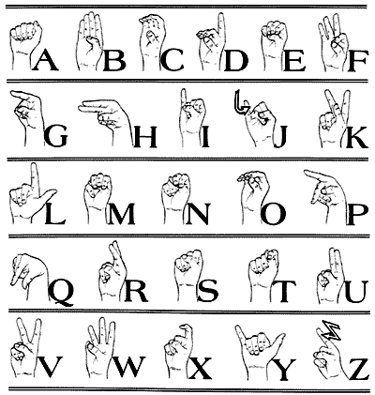
Written Communication
English is often a second language for deaf people so writing may not be “effective communication.”
Medical terminology may be difficult for them to understand.
Try to use simple words and phrases.
A chart of common ASL pictographs, the finger alphabet and a list of “yes or no” questions may be helpful.

Slide 30
Lip Reading
Lip reading should only be relied upon when the disabled person states that is his/her preference.
Speak normally and clearly.
Avoid shouting and over-enunciating.

Slide 31
Request for Facilities
Every facility should establish procedures about how to obtain auxiliary aids and/or interpreters for persons with disabilities.
At a minimum, every Unit Director, the registration staff in the Emergency Department, the Patient Relations Representative, and members of the Social Work Department need to understand those procedures.
The procedures should be sure to address the process for obtaining resources after hours.

Slide 32
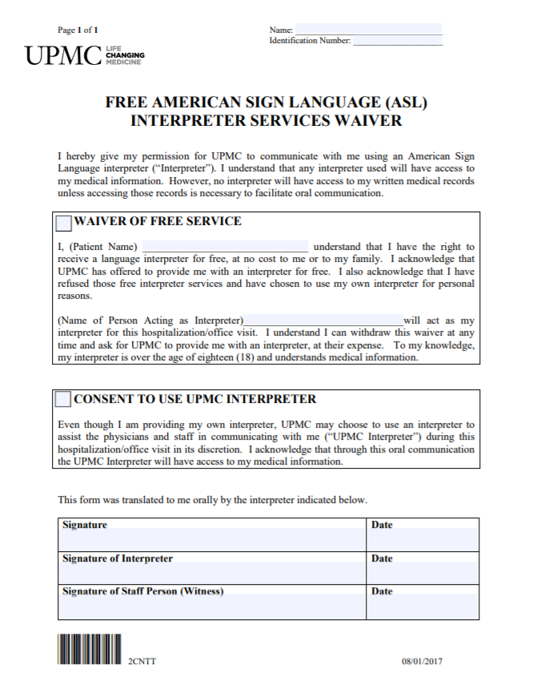
Patient Denial of Interpreters
Patient Waiver Should be Documented: When a patient waives his/her right to a UPMC-contracted interpreter, it must be documented in the medical record. It is also recommended that the patient sign a waiver form.
Waivers Cannot Occur Without Using an Interpreter: All denials must be conducted using a UPMC-contracted interpreter (either live or via VRI).
Provider Interpreter: Providers should try to persuade the patient to let him/her use an interpreter for the provider’s benefit.
Best Practice: Any new diagnosis, informed consent discussions, and other critical conversations should be done using an interpreter.

Slide 33
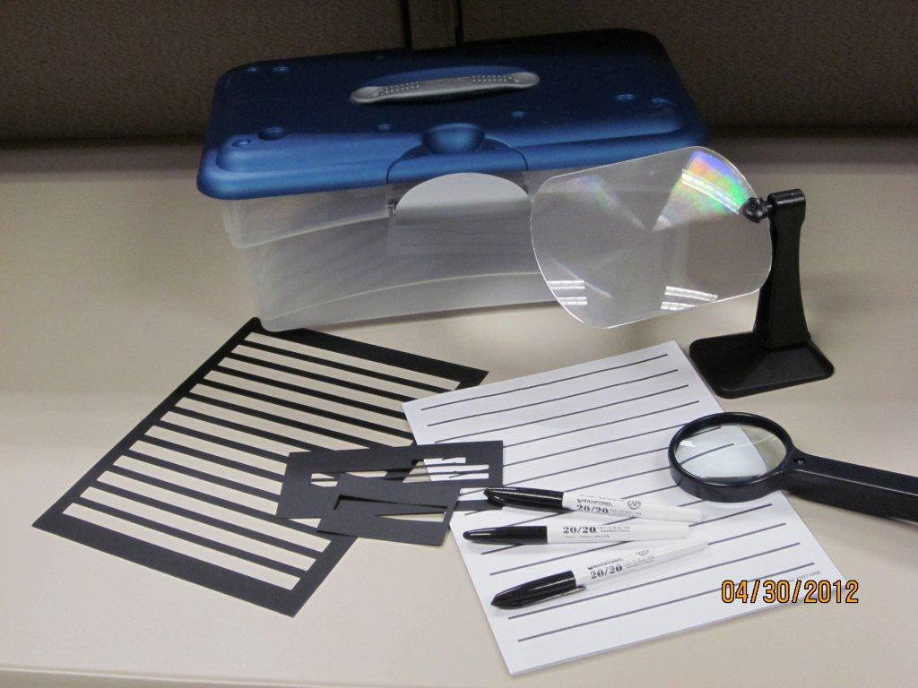
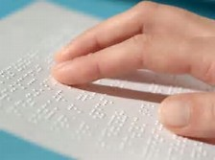
Resources for Accessible Health Care:
Blind/Low Vision
  Blind/Low Vision Toolkits
  Braille Documents

Slide 34
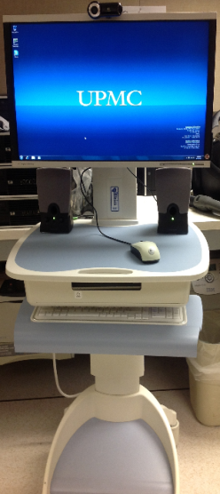
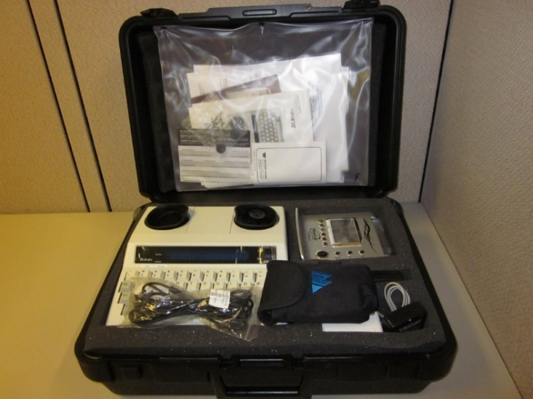
Resources for Accessible Health Care:
Deaf and Hard of Hearing
Assistive Listening Toolkits
Video Remote Interpreting

Slide 35
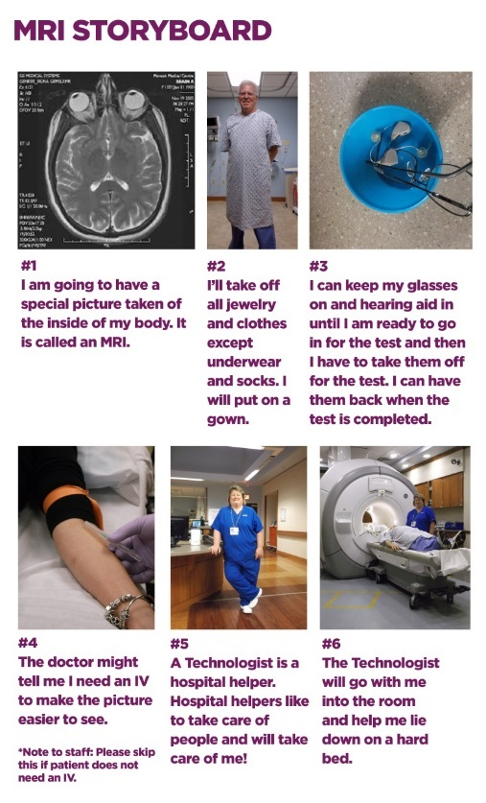
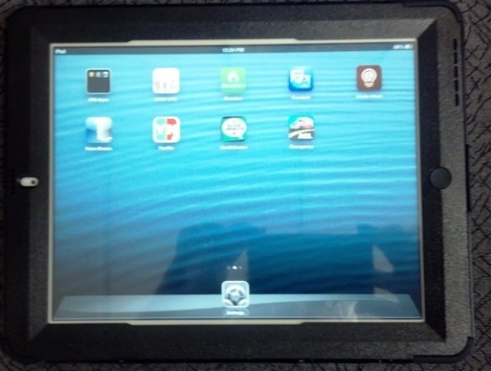
Resources for Accessible Health Care
  Effective Communication iPads
  Story Boards
  Documents in Alternate Format
  Call Bells

Slide 36
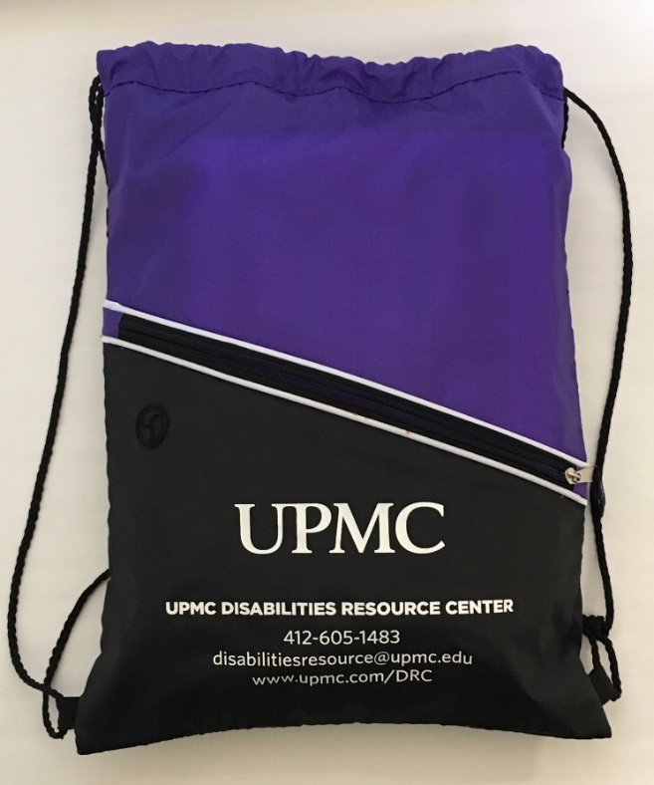
Effective Communication Policy:
Disability Toolkits
Contents
  Tools
  Education Materials
Over 1000 ordered and distributed to practices, outpatient clinics and facilities
  http://infonet.upmc.edu/OurOrganization/HCD/CPS/DRC/Documents/Equipment%20List%20Purchasing.pdf

Slide 37
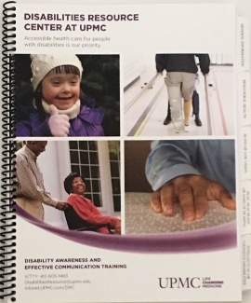
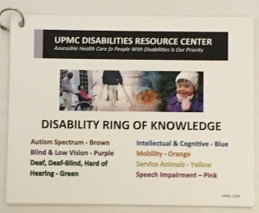
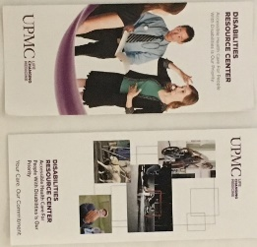
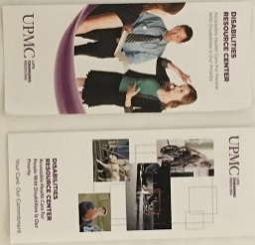
Disability Toolkit Contents
Hand-held Magnifier
Writing Guide Kit
Signature Guides
Bold Lined Paper (Low-Vision)
Communication Boards
Door Knocker
Personal Amplifier +earbuds/ear covers
Instruction sheet on how to use each tool
Instruction sheet on how to sanitize each tool after use
Dry Erase Board
DRC Ring of Knowledge, brochures, and Resource Guide

Slide 38
Video Remote Interpreting (VRI)
Video remote interpreting (VRI) is a fee-based interpreting service conveyed via videoconferencing where at least one person, typically the interpreter, is at a separate location. VRI is used to facilitate communication between those in the same room.
UPMC Vendor: Cyracom
Accessing VRI: Cyracom application is available on a computer with video camera, microphone, speakers, and internet connection plus any of our UPMC Effective Communication iPads.
When is VRI a good option?
Emergencies: When there is an immediate need for interpreters, such as emergencies
Lack of Availability of Onsite Interpreter: When a qualified onsite interpreter is not available, especially in rural areas
Intermittent Needs: When there is intermittent need (less of an issue with office practice)
VRI is a Supplement Not a Replacement: VRI is not meant to replace on-site interpreters, but when used in combination, may provide the best communication plan.
NOTE: VRI should never be the only option. If it doesn’t work. If using it upsets the patient/visitor/guest. If the patient/visitor/guest also has vision impairments, EXPLORE OTHER OPTIONS.

Slide 39










Effective Communication iPads
These iPads include numerous apps to help patients actively participate in their health care.

Slide 40
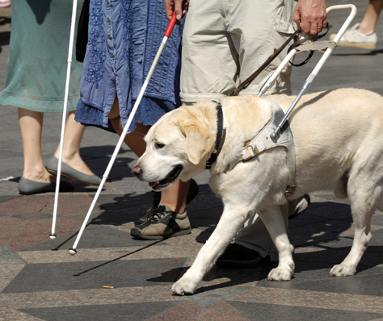
Service Animals
One Size Does Not Fit All: Service Animals provide service to people with many different types of disabilities.
Must Perform Tasks: There must be a direct link between the task the animal is trained to do and the individual’s disability.
There is no “Certification”: Anyone can train a service animal including the owner.
Broad Access: Generally, they are allowed wherever the general public is allowed. (More information to follow.)
Examples of service animals include (list not all inclusive):
  Balance animals
  Seizure detection animals
  Guide animals
  Hearing animals
  Autism service animals
  Mobility animals
Note: The ADA recognizes only two types of animals as service animals:
Dogs
Miniature Horses

Slide 41
Service Animals
Emotional support animals are not recognized by the ADA as service animals unless they are for Post Traumatic Stress Disorder.
A service animal MUST be allowed to accompany the individual with a disability it serves to any area of the office open to the general public, UNLESS:
  The owner refuses to answer questions about the animal.
  The owner is not in control of the animal.
  The admittance of the animal would be a fundamental alteration of the office’s services.
  The admittance of the animal would be a direct threat to the safety, such as:
      The risk of a contagious disease (NOT allergies)
      An aggressive, growling animal

Slide 42
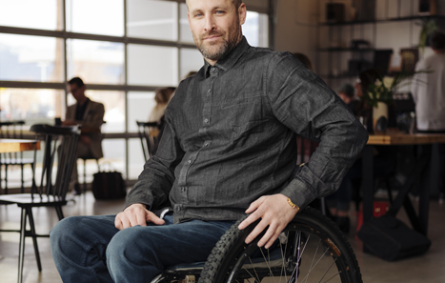
Remember to A-C-T!
  Ask the individual what they need or the best way to help.
  Communicate with the individual, including listening to what they tell you. Communicate with your manager if you are not sure. Communicate during handoffs or transfer of care
  Take Action —Whenever you become aware that an individual requires accommodation for a disability, do something. UPMC reasonably accommodates everyone with a disability.

