Slide 1
Ethics, Disability, and Healthcare 31st Annual Interprofessional Healthcare Ethics Conference April 12, 2024 Center for Bioethics & Health Law | University of Pittsburgh
Medical Decision Making
on the
Autism Spectrum
David Kappel, MD, FACS
Valerie Violi Satkoske, MSW, PhD, HEC-C
Joann Migyanka, DED
Andrew Nelson, Ed.D

Slide 2
“Human civilization will suffer irreparable loss if diversity is treated as a menace and cultures with all their treasures, including languages, literature, art, music, medicine, and moral visions, are restricted within narrow limits. Culture is broader than, and inclusive of, ethics. There can be no true respect for cultural diversity without accepting the possibility and reality of diverse moral worldviews; respect for cultural diversity means acknowledgment, appreciation and respect for diverse moral traditions. ”
(Chattopadhyay & DeVries, 2013)

Slide 3
Questions to Ponder
Due to the unique information processing and communication behaviors of many capacitated adults with Autism Spectrum Disorder (ASD):
Are they capable of engaging in advance care planning and/or acting as surrogate healthcare decision makers?
Do clinicians feel comfortable identifying patients with ASD & assessing their decision making capacity?
Do clinicians know how to effectively communicate with ASD individuals?
Does stigma and lack of education play in clinicians inattention to the inclusion of ASD patients and family members in advance care planning?
What are the prior experiences of individuals on the spectrum when interacting with healthcare providers?
Might tools, visuals, and guides assist people with ASD in advance care planning for themselves and to act as surrogate for those they love?

Slide 4
To answer these questions, one must first examine the impact of “stigma” on:
The behavioral responses of the individual on the spectrum
The interactions and decisions made by healthcare providers

Slide 5
Stigma Defined
n. the negative social attitude attached to a characteristic of an individual that may be regarded as a mental, physical, or social deficiency. A stigma implies social disapproval and can lead unfairly to discrimination against and exclusion of the individual
American Psychological Association Definition

Slide 6
Stigma Defined
“…maintaining moral status is dependent on meeting social obligations and norms. Individuals with (or associated with) stigmatised conditions are de facto unable to meet these requirements. Thus, stigma decays the ability to hold on to what matters most to ordinary people in a local world, such as wealth, relationships and life chances”
Kleinman, A., Hall-Clifford, R. (2009). Stigma: a social, cultural and moral process, Journal of Epidemiological Health: 63(6), 418-419.

Slide 7
Framing Effect
Cognitive bias
Decision is based on whether the options are presented with positive or negative connotations
Framing effects are associated with interoception and alexithymia in the neurotypical population
Interoceptive signals have less influence on the decision-making process in ASD

Slide 9
Clinician Comfort with EOL and ASD
Zerbo O, Massolo ML, Qian Y, Croen LA. A study of physician knowledge and experience with autism in adults in a large integrated healthcare system. J Autism Dev Disord. 201545(12): 4002-4014. https://doi.org/10.1007/s10803-015-2579-2. Accessed July 3, 2019.
2016 National Poll of physicians by The John A. Hartford Foundation
46 percent reported they frequently felt unsure of what to say during EOL conversations
29 percent reported having formal training on how to have an EOL conversation
A 2015 study of 922 healthcare providers found that most reported:
lacking the skills and the tools to provide care for the adult ASD population
gaps in their knowledge of ASD, and
adult providers were unaware that they had patients with ASD, despite reportedly having received some training in ASD

Slide 10
Our Study:
Personal Perspectives of Adults on the Autism Spectrum: Shared Experiences Interacting with the Medical Community
Three-phase study utilizing input from autistic adults and clinicians to create advance care planning conversation guides and documents.
Utilized focus groups with a diverse group of autistic adults to discuss their:
experiences with health providers and institutions, their medical decision-making histories
comfort levels with end-of-life discussions
self-assessed abilities to act as a surrogate decision maker.
feedback and recommendations for healthcare tools that would improve the process

Slide 11
Phase 1: Healthcare Experiences
Themes
Communication
Accomodations
Decision Making

Slide 12
Communication Themes
Communicating about Advanced Care Directives
May choose not to disclose their ASD
Advice to clinicians
Be straightforward
Provide more accessible forms (visual, decision tree)
Allow social supports and permission to talk with parents/team
“Even if it’s dark, it’s important to say what you mean and mean what you say.”

Slide 13
Accomodation Themes
Environmental
Move to a low stimulus environment
Giving time and space to prepare
Communication
Technology-email prior to discussion, portals
Allow for alternative augmentative comm (AAC)
Provide detailed procedures and instructions
Trauma-informed care and communication
Advocates
A Team of family, friends, service providers
Often, the doctor is essential team member
“Luckily, a lot of places with me have been great, letting me avoid waiting rooms altogether. They text me when to come in.”

Slide 14
“We need to provide additional training to providers and facilities especially on autism and developmental disabilities…I haven’t encountered many hospitals that have disability training.”

Slide 15
Decision Making Themes
Medical Decisions
Social supports
Time to process and prepare
Provide credible research resources
Competency
Feel the need to exude competency
Uncomfortable taking sole control of health decisions
Negative experiences regarding perceived incompetence
Acting as Proxy
Limited experience, yet assigned as guardian
Communication is the key
Emotional response varies
“People look at me and they're like, OK, well, I'll just give you like some cursory guidelines. You got this. You're fine. And I leave and I'm not…I'm lost.”

Slide 16
“If I had to make end of life decisions for my wife[…]I would think about every conversation we ever had and would give you all of the conflicting evidence to show you both sides of all the things that she said, show how inconsistent they were, and then be so riddled with the inability to make the right decision that I don't think I could live with myself.”

Slide 17
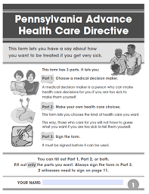
Phase 2: Feedback on Tools
Themes
Presentation
Information
Format

Slide 18
Presentation Themes
Face and Body Language
Do not overly rely on cues, trust words
May not show emotion or may display inappropriate emotion
Direct Communication - Time to Prepare
Use guided prompts, empathetic listening
Share materials/appt. expectations early for review
Online access via patient portal or email
Provide “bill of rights” that needs to be clear and accessible**
Advocates
Importance of team of family, friends, providers
Caution about over reliance on “expert”

Slide 19
“I'm not exactly the type of person that really wants to show my emotions, even like if I am experiencing them… As far as like judging by facial reactions or like inflection and all that, that's not something that necessarily is going to help with me because I don't try to show that a lot or I just don't know how to show that.”

Slide 20
Information Themes
Terminology
Terms like recovery, critically ill, etc.
Need for definitions and specificity
Choices
Likelihood of outcomes
Impact on Quality of Life
Need for specificity
“If it's a real substantial shot at longevity. You know, I wanted to know what those odds were, because I want him to get the maximum care. And I actually felt like I could not make an informed decision based on the things she was saying”

Slide 21
“I’m not really swayed very much by people’s emotional ideas about what I should be doing. So, I don’t really ask people and when I do ask for advice, it’s never asking them what they think the right thing to do is, because I really don’t care what they think is right. I want to do what makes medical sense like avoiding death and infection.”

Slide 22
Format Themes
Readability
Spacing and minimizing text
Clear structure
Add glossary and definitions to the end
Visuals
Color is important - black text on white can be a challenge
Use color coding
Incorporate clear and instructive graphics
Embed reputable links
It was color coded, so you knew what went with what. Really anything to make it so you don't gloss over it, especially when you're overwhelmed.”

Slide 23
Patient Competence
and
Self-Advocacy
Decision Making Capacity:
appreciate their situation
understand the risks and benefits of proposed interventions
can explain reasoning behind their decisions and communicate them
*informed consent must be voluntary
If a person cannot exercise their right to make decisions for themselves based on their own values and preferences, then they have the right to a surrogate to advocate on their behalf

Slide 24
“I would panic, totally, completely…”
“...I have very few people that I would actually care enough to be panicked over, but the few people that I would if I like, I'm like my if my if interception I had to make end of life decisions for my wife and you ask me what would she want? I would think about every conversation we ever had and would give you all of the conflicting evidence to show you both sides of all the things that she said, show how inconsistent they were, and then be so riddled with the inability to make the right decision.That I don't think I could live with myself. I mean, it's something that like even just thinking that off the top of my head now I'm thinking to myself, like, I need to make sure that she writes that first off immediately because my life is hard enough and I don't need that extra. Because I could not navigate that. It would be so crippling that I honestly think I'd have to be hospitalized”

Slide 25
Summary of Outcomes
History of being underestimated and misunderstood by providers
Anxiety of interacting with medical community
Needing time, straight forward language, and a calm environment to make decisions
Access to support from trusted family, caregiver or PCP during medical situations/interactions
If possible-provide advance information and time to process and ask questions
Accommodations
Slow Down
Deliberate Communication

Slide 26
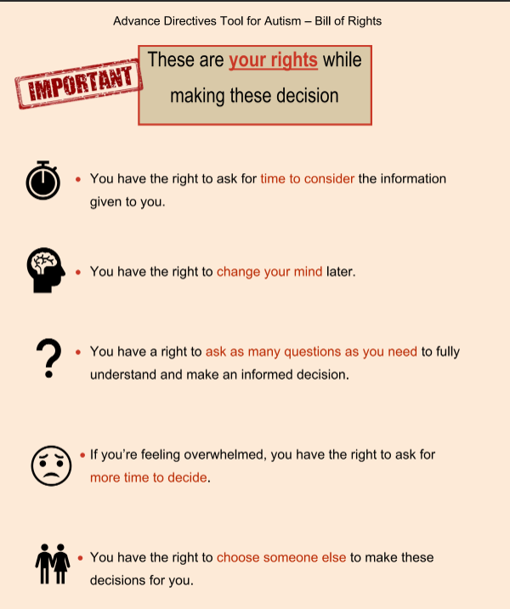
Project Deliverables:
Bill of Rights
Clinician Communication Guidelines
Advanced Directives Tool

Slide 27
Bill of Rights

Slide 28
Communication Guidelines

Slide 29
Communication Guidelines

Slide 30
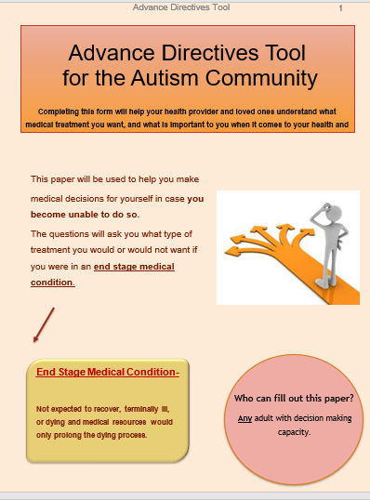
Advanced Directives Tool
Built using feedback from the focus groups.

Slide 31
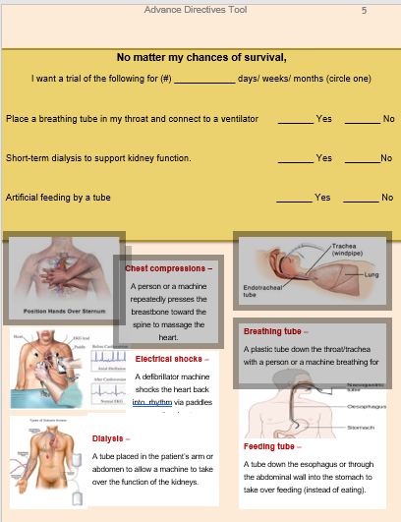
Advanced Directives Tool
Built using feedback from the focus groups.

Slide 32
Thank You!
Any Questions?

