Slide 1
Ethical, Legal, and Social Challenges for Neurodivergent Adults in our Communities: Shifting to a Supported Engagement Model
Nanette Elster, JD, MPH
Kayhan Parsi, JD, PhD, HEC-C
Neiswanger Institute for Bioethics
Loyola University Chicago Stritch School of Medicine

Slide 2
Disclosures
No conflicts to disclose
Views expressed are our own and do not reflect the views and/or opinions of our institutions
We are neurotypical parents of neurodiverse adult children

Slide 3
Overview
What is neurodiversity?
Defining transition
Entitlement v. Eligibility
Supported Decision-making
Supported Engagement
What?
Why?
How?
Some examples

Slide 4
“Neurodiversity”
Term coined by Australian sociologist Judy Singer in her 1998 thesis
The term refers to the different way that people’s brains work including Autism, ADHD, etc.
It was intended by Singer to be both a scientific and political term

Slide 5
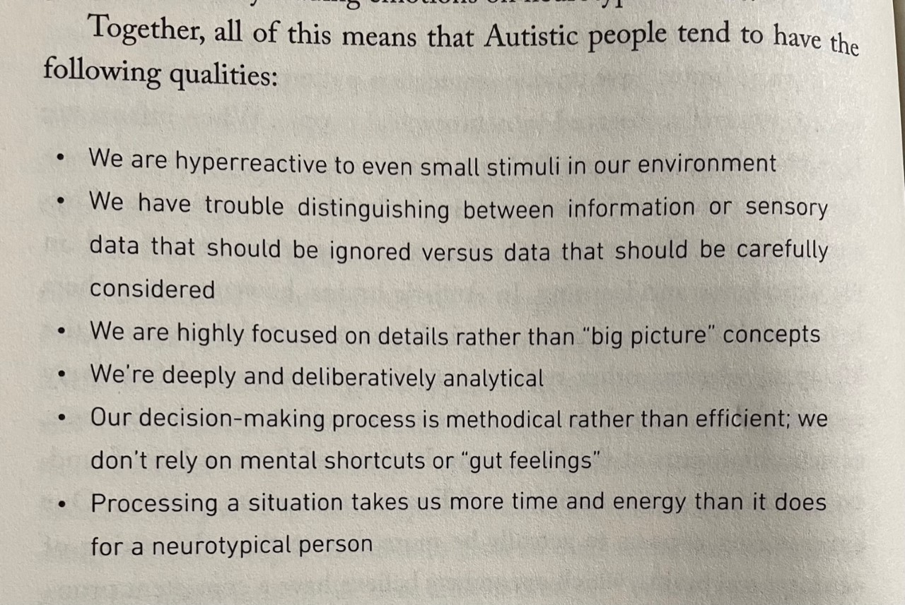

Slide 6
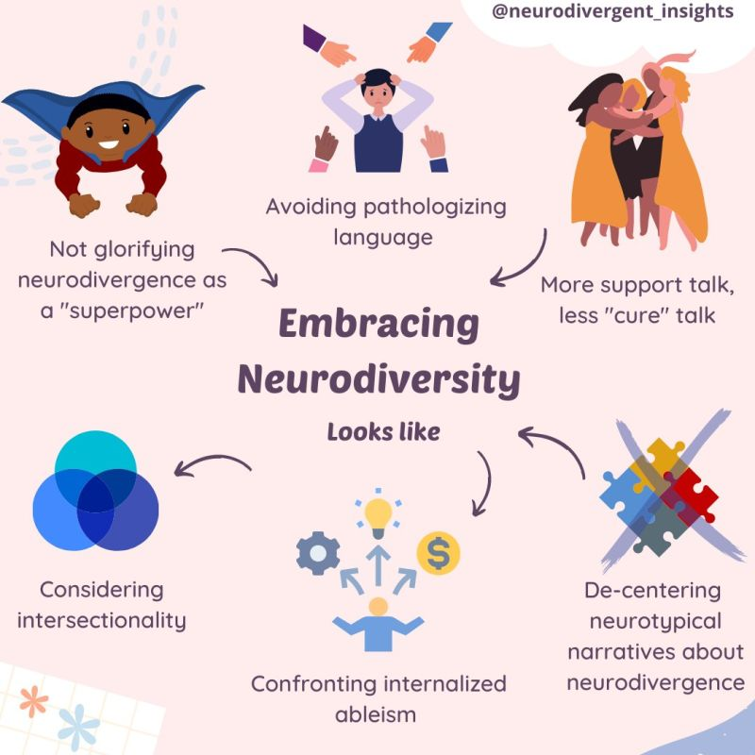

Slide 7
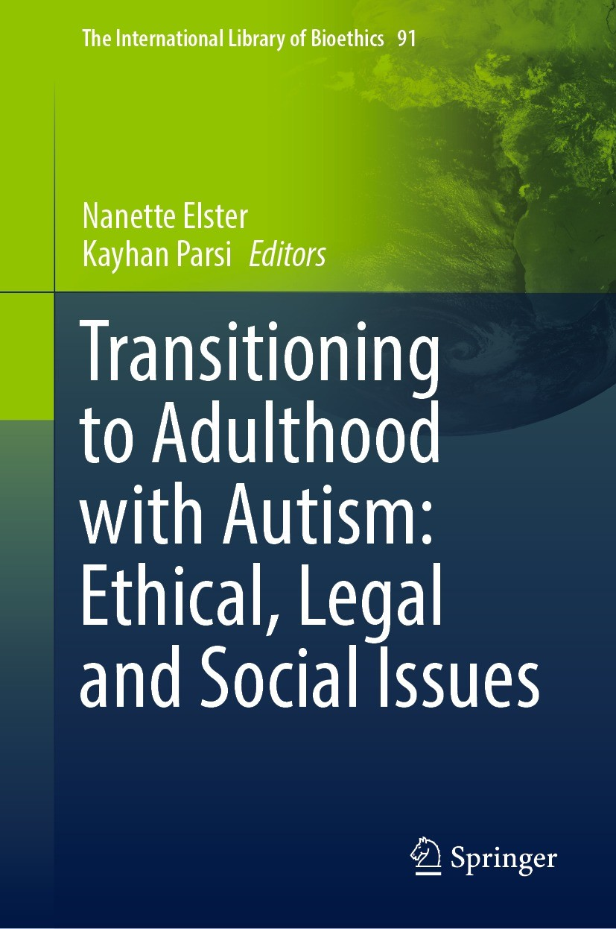
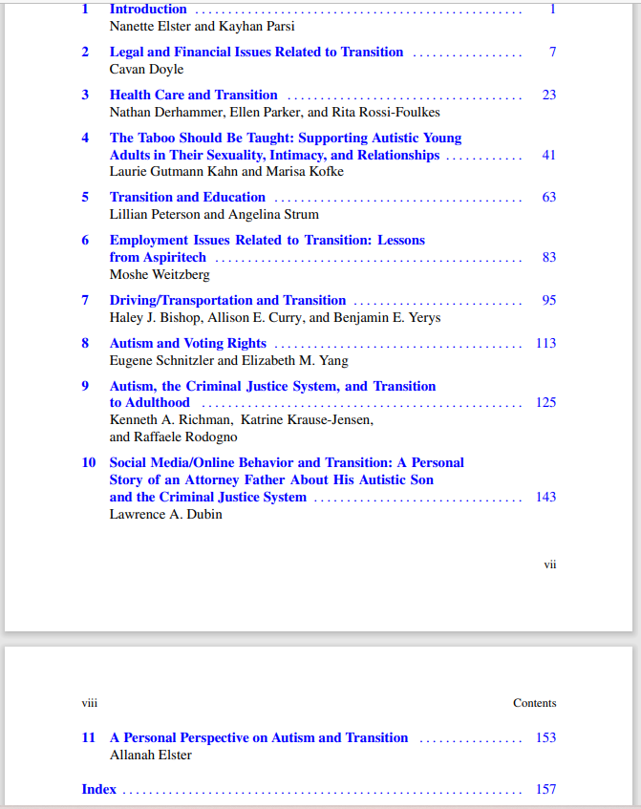

Slide 8
The Power of Narrative: Their Stories (with permission)

Slide 9
Transition: A Process not an Event

Slide 10
Transition Defined
“movement from adolescence to adulthood in all areas, including:
home
health care
education
community.
Transition should be a process rather than an event.
Optimally, a child, his or her family, and the practitioner should be preparing for transition throughout childhood and adolescence.”
(Shaw, DeLaet, “Transition of Adolescents to Young Adulthood for Vulnerable Populations,” 31 (12) Pediatrics in Review (2010).)

Slide 11
Moving from Childhood To Adulthood: From Entitlement to Eligibility
Services
Eligibility
(After age 21)
Burden on the Individual/family
Entitlement
(Under age 21)
Burden on the State

Slide 12
What Transition Means
Child
Adult
Entitled to services
Housing
Healthcare
Social
Parents/Guardians decision makers
Coordination of care
Eligible for services
Housing
Healthcare
Employment
Can make own decisions (unless determined otherwise)
Exaggeration of disparities

Slide 13
Systemic Barriers in the Transition Period
“Unmet service needs for adults with ASD may also emerge because many states’ policies and programs were not developed to meet the lifespan needs of individuals with ASD.”
(Turcotte, et. al. J Autism Dev Disord (2016) 46:2480–2489)

Slide 14
What Happens After Transition?
ADULTHOOD

Slide 15
1 in 36 Children
1 in 45 Adults
Rates of Autism in the US

Slide 16
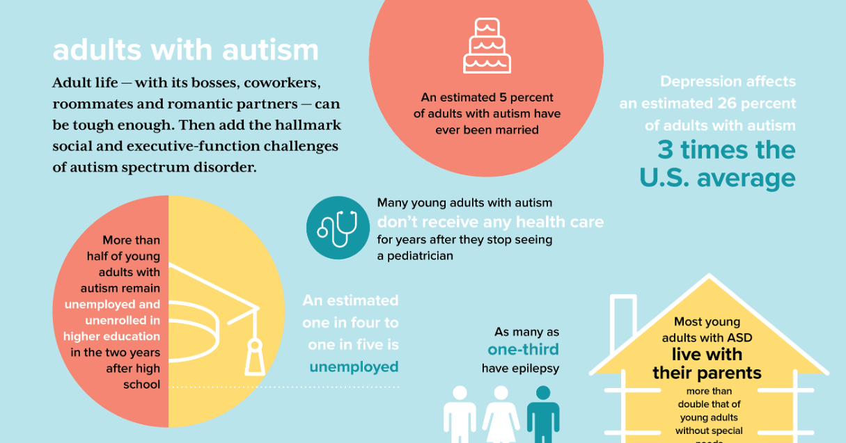
Credit:
UC Davis

Slide 17
Unmet Needs of Autistic Adults
Adults with ASD
Employment
Healthcare
Housing
Other Services
Occupational Therapy
Physical Therapy
Coordination of Services

Slide 18
Decision Maker Options
State-appointed guardian
The individual
The individual and their support person(s)

Slide 19
Expanding the Concept of Supported Decision-Making to Supported Engagement
Supported Decision Making
Supported Engagement
Social Justice & Human Flourishing

Slide 20
Moving from a Biomedical Model to a Psycho-Social Model to Enhance Supported Engagement
Biomedical
Psycho-Social
Focus on biological factors/pathology
Physician/Medical focus
Focus on diagnosis and cure
Considers cultural and social factors – look at the whole person
Inclusive of other providers
Focus on prevention/sustainability

Slide 21
Supported Engagement
What is it?
Why do we need it?
How will it work?

Slide 22
Supported Engagement—What, Why & How
A new conceptual framework that acknowledges relational autonomy
Builds on the concept of supported decision-making
Moves beyond mere decision-making by effectuating those decisions
Highlights engagement with neurodiverse individuals and their support needs (as well as the support needs of their caregivers)
Extends beyond individual supporters
Extends beyond those with impaired decision-making capacity
Encompasses institutions and organizations (both public and private)
Recognizes the need for a participatory approach to policy development

Slide 23
Individual Engagement
Healthcare
Relationships
Self care

Slide 24
Healthcare
Medical
Oral
Mental

Slide 25
Relationships

Slide 26
Self Care

Slide 27
Local Community Engagement
Spirituality
Housing
Employment

Slide 28
Spirituality

Slide 29
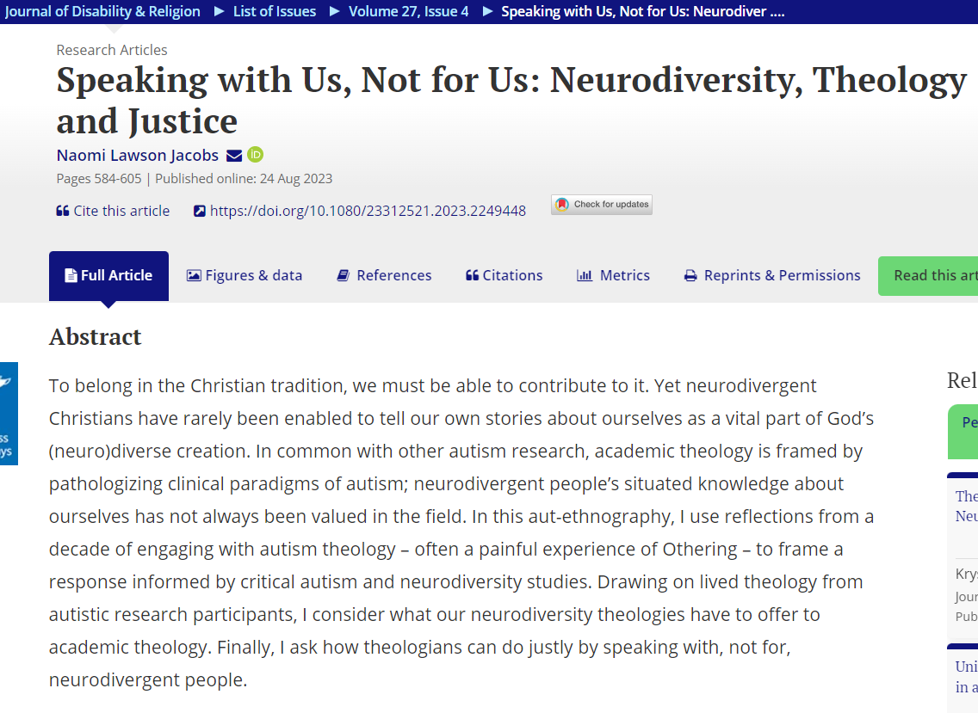

Slide 30
Housing

Slide 31
Employment

Slide 32
Broader Civic Engagement
Advocacy
Policy-making
Political process

Slide 33
Advocacy

Slide 34
Policy-making

Slide 36
Political Process

Slide 38
A Closer Look at a few Examples
Employment
Self-Care
Housing
Sexual/Reproductive Health

Slide 39
Employment
A greater challenge for those with intellectual or developmental disabilities

Slide 41
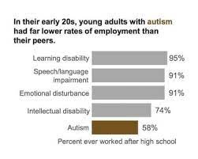
Roux, Anne M., Shattuck, Paul T., Rast, Jessica E., Rava, Julianna A., and Anderson, Kristy A. National Autism Indicators Report: Transition into Young Adulthood. Philadelphia, PA: Life Course Outcomes Research Program, A.J. Drexel Autism Institute, Drexel University, 2015.

Slide 42
Why Employment Matters
“Employment for wages contributes to individual economic and social well-being, is linked to positive health outcomes, is a gateway to health insurance, and is a factor in quality of life.”
Roux, et al. Postsecondary Employment Experiences Among Young Adults With an Autism Spectrum Disorder. J Amer Acad Child Adol Psych. Vol. 52. No. 9. Sept 2013.
42

Slide 43
Self-Care
ADLs
Masking

Slide 44
Masking
“Camouflaging”
“Passing”
“Adapting”
“Compensating”
Defined: “adopting specific strategies to navigate the neurotypical social world, to the point [of appearing] non-autistic or less autistic in some circumstances.” (Petrolini et al., 2023)

Slide 45
More common in:
Women
BIPOC
LGBTQ
Those with better executive function

Slide 46
Forms
Forced eye contact
Stifling self-soothing stims
Studied/scripted responses
Tamping down sensory discomfort

Slide 48
The “Cost of Unmasking”
“The cost of unmasking is too high, especially after a lifetime of being reminded that our Autistic traits are undesirable. Despite being exhausting, harmful to our mental health, and a fundamental denial of our identity, our mask is necessary. It is marginally less damaging than facing the full force of ableism — but it is still damaging.”

Slide 49
The Cost of Masking
Stress
Lacking a sense of belonging
Depression
Suicidality
This can lead to a phenomenon that has been identified as “Autistic Burnout”

Slide 50
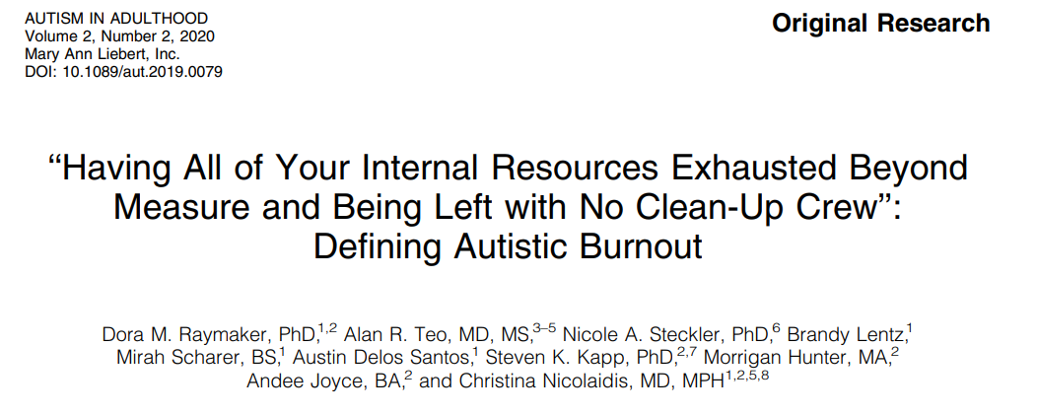

Slide 51
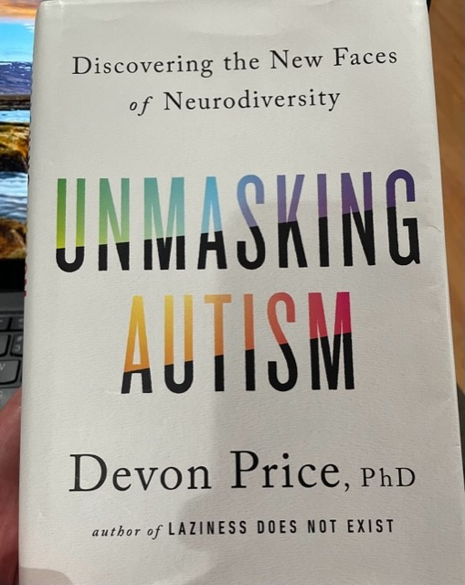

Slide 52
Housing

Slide 53
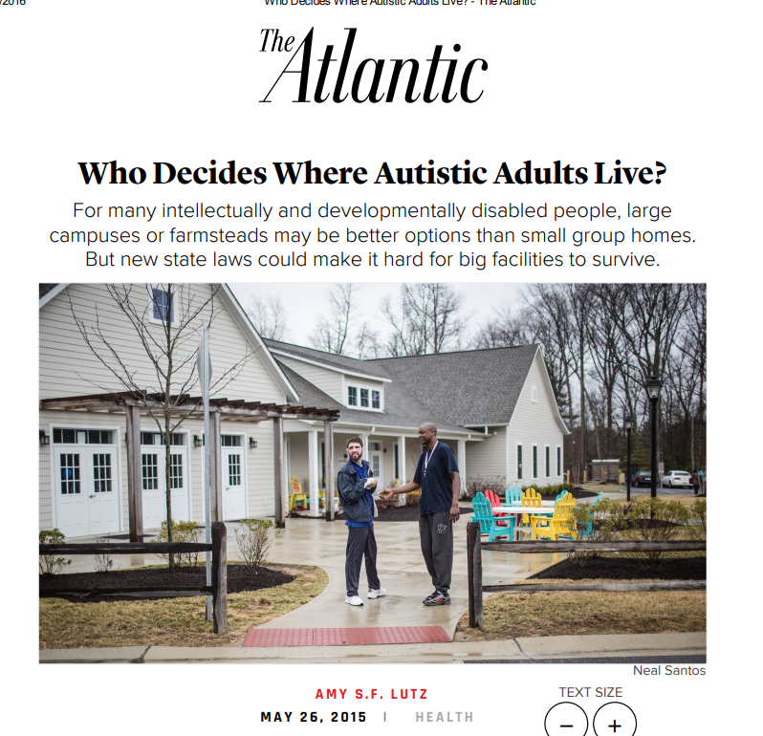
53

Slide 54
Housing
Where to live?
How to manage a household?
With whom to live?
Why is this important?
HOUSING

Slide 55
Housing for Autistic Adults
“Residential independence has often been viewed as a key marker of entry to adulthood.”
“Young adults with an ASD resided with a parent or guardian at higher rates and for longer periods of time after leaving high school than young adults with ED, LD or MR.
Moreover, young adults with an ASD had the highest rate of supervised living arrangements and the lowest rate of independent living since leaving high school.”
KA Anderson, et. al., “Prevalence and correlates of postsecondary residential status among young adults with an autism spectrum disorder,” Autism. 2014 Jul; 18(5): 562–570.)
55

Slide 57
Sexual & Reproductive Health

Slide 58
Sexual Health & Well Being
“…a state of physical, emotional, mental and social well-being in relation to sexuality; it is not merely the absence of disease, dysfunction or infirmity. Sexual health requires a positive and respectful approach to sexuality and sexual relationships, as well as the possibility of having pleasurable and safe sexual experiences, free of coercion, discrimination and violence. For sexual health to be attained and maintained, the sexual rights of all persons must be respected, protected and fulfilled.” (WHO, 2006)

Slide 59
Issues Related to Sexual Health & Well Being
Menstruation
Masturbation
Social Connection
Legal Considerations
Sexual Abuse
Contraception
STI Awareness/Prevention
Sexual Orientation/Identity
Pregnancy/Parenting

Slide 60
Sex Education
“No matter their level of interest in dating, relationships, and sex, it is critical that adults on the spectrum receive education to help effectively communicate their needs and desires, to understand accurately how their bodies work, to know their rights, and to have access to available resources for sexual and reproductive health.”
(Solomon D, Pantalone DW, Faja S. Autism and Adult Sex Education: A Literature Review using the Information-Motivation-Behavioral Skills Framework. Sex Disabil. 2019 Sep;37(3):339-351.)

Slide 61
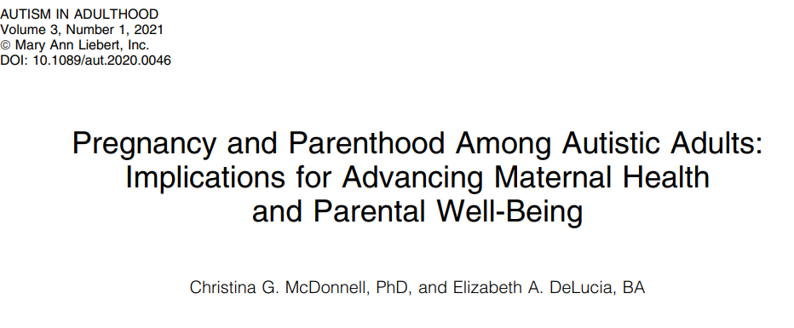
Pregnancy & Parenting
“Better understanding these experiences is important, because pregnancy and parenthood are key transition periods in adult development that are associated with a range of health outcomes later in life.”

Slide 62
What Can be Done?
Expand state services to educate communities about neurodiversity
Develop supportive services for neurodiverse individuals and their support persons
Encourage employers, health care providers, etc. to focus on the strengths and contributions rather than on deficits
Identify meaningful engagement of neurodiverse individuals based on the individual rather than stereotypes

Slide 63
What Can be Done?
Increasing awareness of procedures to gain needed services coverage
Insurance
Education
Assistive/Therapeutic Services
Educate neurodiverse individuals about political engagement
Consider the individual support needs of:
Autistic individuals (w/ and w/o ID)
Support persons of autistic adults
Education
Community consultation
Voting
Running for office
Housing
Employment
Transportation

Slide 64
Conclusion
“In the face of these desperate needs, it’s time for our community to stand strong and advocate for the services needed for ourselves and families. Wealth, race, or cognitive/educational privilege should not be the deciding factor predicting who survives and prospers in living an autistic life. The rising autism numbers presented by our CDC should be a wake-up call — there are a lot of us, and what’s truly increasing is the cost of ignoring our needs. It is high for us as individuals and for families — and even higher for society.”
JE Robison. D Gassner. There is no epidemic of autism. It’s an epidemic of need. Statnews. 3/23/23

Slide 65
Contact Information
Nanette Elster, JD, MPH – nelster@luc.edu
Kayhan Parsi, JD, PhD – kparsi@luc.edu
Please connect with us on LinkedIn

