Slide 1
Justice for All?
Bioethics in/and Prognostication Ableism,
And the
Disability Paradox
Ethics, Disability, and Healthcare
12 April 2024
Center for Bioethics and Health Law
University of Pittsburgh
Amanda K. Booher, PhD, Hec-c
Bioethicist, Summa Health
boohera@summahealth.org
Notes:
This talk emerged from a few directions. Underlying all of this is my work and interest and commitment to disability studies and disability justice. One was being witness to conversations had by different specialities about patients with brain injuries, and seeing some very different interpretations of potential outcomes for these patients–with particular concerns about how this affected decision-making, for the patient or their surrogates.. The second was an article shared by our head of trauma with a number of people to consider if we should change anything in our approach (I’ll talk more about that in a minute). Third, I was asked to present for a Neuroscience Grand Rounds at Summa, and in advance had a talk with some of their providers, including Madihah Hepburn, one of the neurocritical care attendings, about some of what I’ve noticed and the intersection of issues and perceptions of disability. Those things became this talk, which I’ve adapted it here for the different audience. Lucky for me, my talk was the month following Dr. Hepburn’s talk titled “The Fallacy of Neuroprognostication: Pitfalls in Prognosticating Acute Brain Injury” – which meant no one needed my two cents on the complexities of neuroprognostication in itself.
Potentially unfortunately, you’ll get a little of my 2-cents here – so, on to neuroprognostication…

Slide 2
Bioethics Justice
Aristotle, “"giving to each that which is his due"
To each person an equal share
To each person according to need
To each person according to effort
To each person according to contribution
To each person according to merit
To each person according to free-market exchanges
Ala Beauchamps & Childress

Slide 3
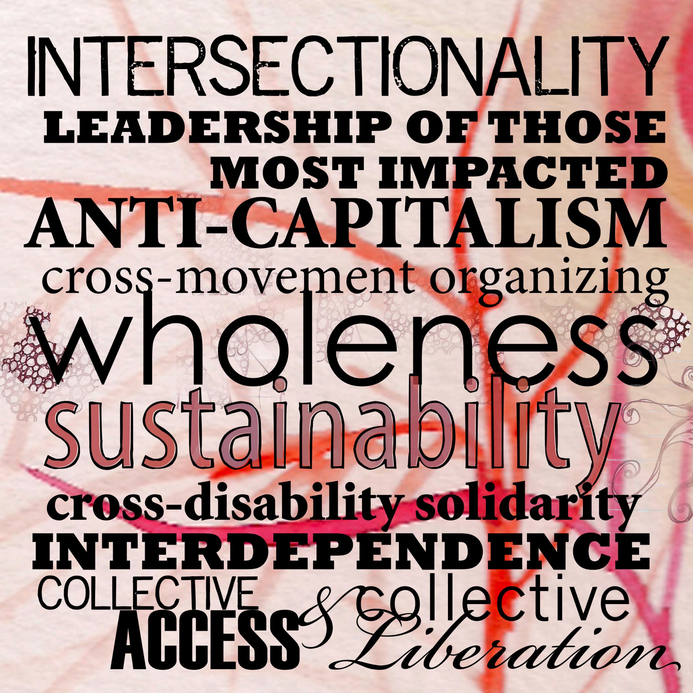
Disability Justice
Notes:
This center image is from the organization Sins Invalid (https://www.sinsinvalid.org/blog/10-principles-of-disability-justice), and is a stylized version of their “10 Principles for Disability Justice”

Slide 4
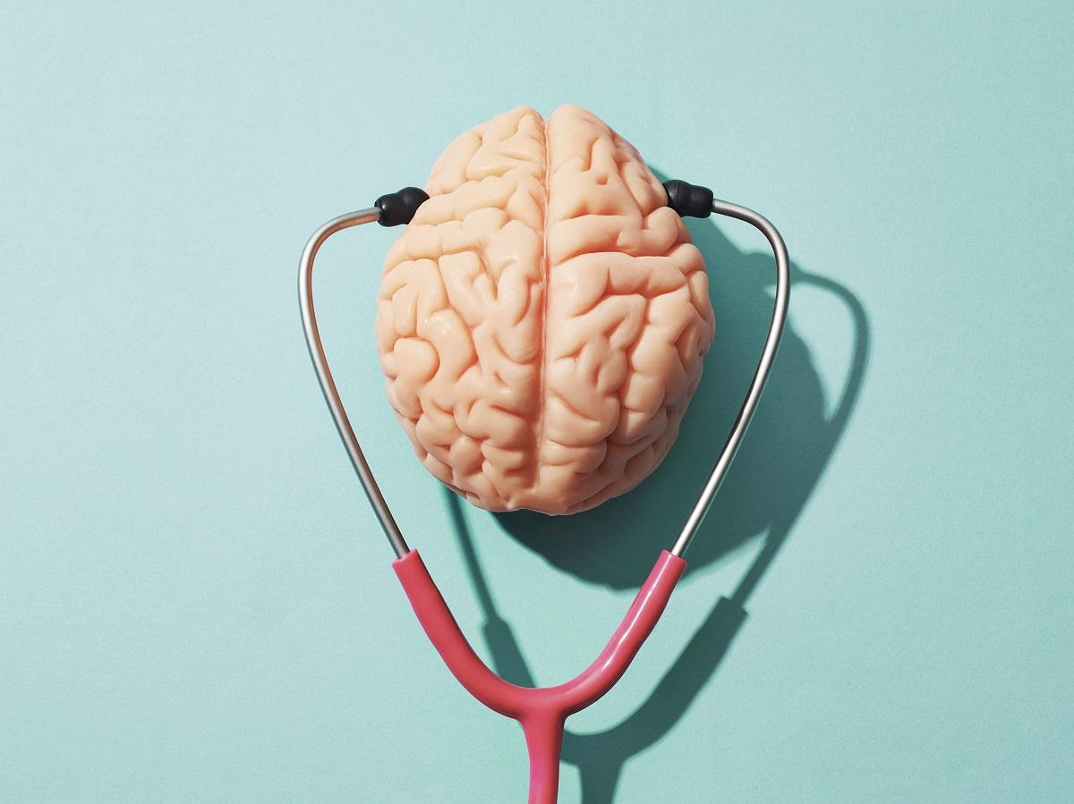
oruen
neuro
noitacitsongorp
prognostication
“With profound implications for mortality and quality of life, neuro- prognostication draws upon an intricate set of biomedical, probabilistic, psychosocial and ethical factors.”
What level of consciousness and functionality …is the patient likely to regain?
what is the likely time frame for recovery?
considering the patient’s values, what quality of life would such a recovery be likely to yield?
Fischer D, Edlow BL, Giacino JT, Greer DM. Neuroprognostication: a conceptual framework. Nat Rev Neurol. 2022 Jul;18(7):419--427.
what level of confidence is associated with each prediction?
Notes:
Fischer et. al, in their 2022 article “Neuroprognostication: A conceptual framework” define neuroprognostication as [CLICK] “the prediction of recovery from disorders of consciousness caused by severe brain injury.”
They continue to contextualize, writing that neuroprognostication “is as critical as it is complex.” It has “profound implications for mortality and quality of life” and “draws upon an intricate set of biomedical, probabilistic, psychosocial and ethical factors.” (emphasis mine)
They also suggest how neuro prognostication is different from general medical prognostication, noting that for many conditions, someone presents at a baseline, and the “task of the clinician is to predict the severity of future disease”. However, neuroprognostication [CLICK] “ operates in reverse.” Noting that
“The causes of severe brain injury — such as trauma, hypoxia, ischaemia and haemorrhage — typically occur acutely”, and providers are working to “determine the likelihood of improvement”.
Fischer et. al highlight
The sudden, unpredictable and severe nature of such injury” and how this nature “presents unique challenges, as critical clinical decisions must often be made rapidly, and patients typically cannot express their wishes or participate in those decisions” (we’re getting close to ethics here!)
I want to highlight one last element of their definition here, and this is the four questions that neuroprognostication is attempting to address: [CLICK]
First, what level of consciousness and functionality (both physical and cognitive) is the patient likely to regain?
[CLICK]
Second, what is the likely time frame for recovery?
[CLICK]
Third, considering the patient’s values, what quality of life would such a recovery be likely to yield?
[CLICK]
Last, what level of confidence is associated with each prediction?
So this brings us to the crux of this conversation: neuroprognostication is quite complex, not only clinically. There are inherent intersections with complex issues of decision-making, capacity, and patient/family values. There are also inherent intersections with disability–medically, socially, individually, financially, and otherwise. The questions I want to explore today, then, are how do we attend to these complexities? And what might we do in light of these intersections, particularly in supporting patients and surrogates (and teams) in the decisions that face them?

Slide 5
Consciousness
“…[consciousness] is not a unitary state but rather a cluster concept that includes a number of interdigitated ingredients;…in isolation, each is not sufficient but when vari- ably combined produce a range of states that fall on a spectrum of what we call consciousness, and each of which might be variably disordered across the spectrum of conditions that neurologists are called upon to evaluate…
…Across definitions, consciousness appears to be subjective, related to experience and serves as a grounds for the possibility of other capacities. (3293)
Notes:
Work by Young et. al, a 2021, article titled “The neuroethics of disorders of consciousness: a brief history of evolving ideas” in Brain, helps provide some further framing for where and how ethics intersects with neuroscience
The article is interesting in its intertwining of philosophy and neuroscience and the authors are particularly interested in the question of consciousness (and relatedly disorders of consciousness, or DoC): what consciousness is, and what value it holds, is fundamental to any understanding of outcomes. This is also evident in Fischer, et. al, as part of the fundamental questions of neuroprognostication (and my understanding is that different levels of consciousness have different recovery predictions).
I’m not going to delve too deeply here into how we define consciousness (though it tickles my rhetorical brain), except to highlight this quote.
…[consciousness] is not a unitary state but rather a cluster concept that includes a number of interdigitated ingredients;…in isolation, each is not sufficient but when vari- ably combined produce a range of states that fall on a spectrum of what we call consciousness, and each of which might be variably disordered across the spectrum of conditions that neurologists are called upon to evaluate…
…Across definitions, consciousness appears to be subjective, related to experience and serves as a grounds for the possibility of other capacities. (3293)
It’s notable to me both in its accuracy and it’s potential incomprehensibility (interdigitation?), were we to take this directly into conversation with patients and families.

Slide 6
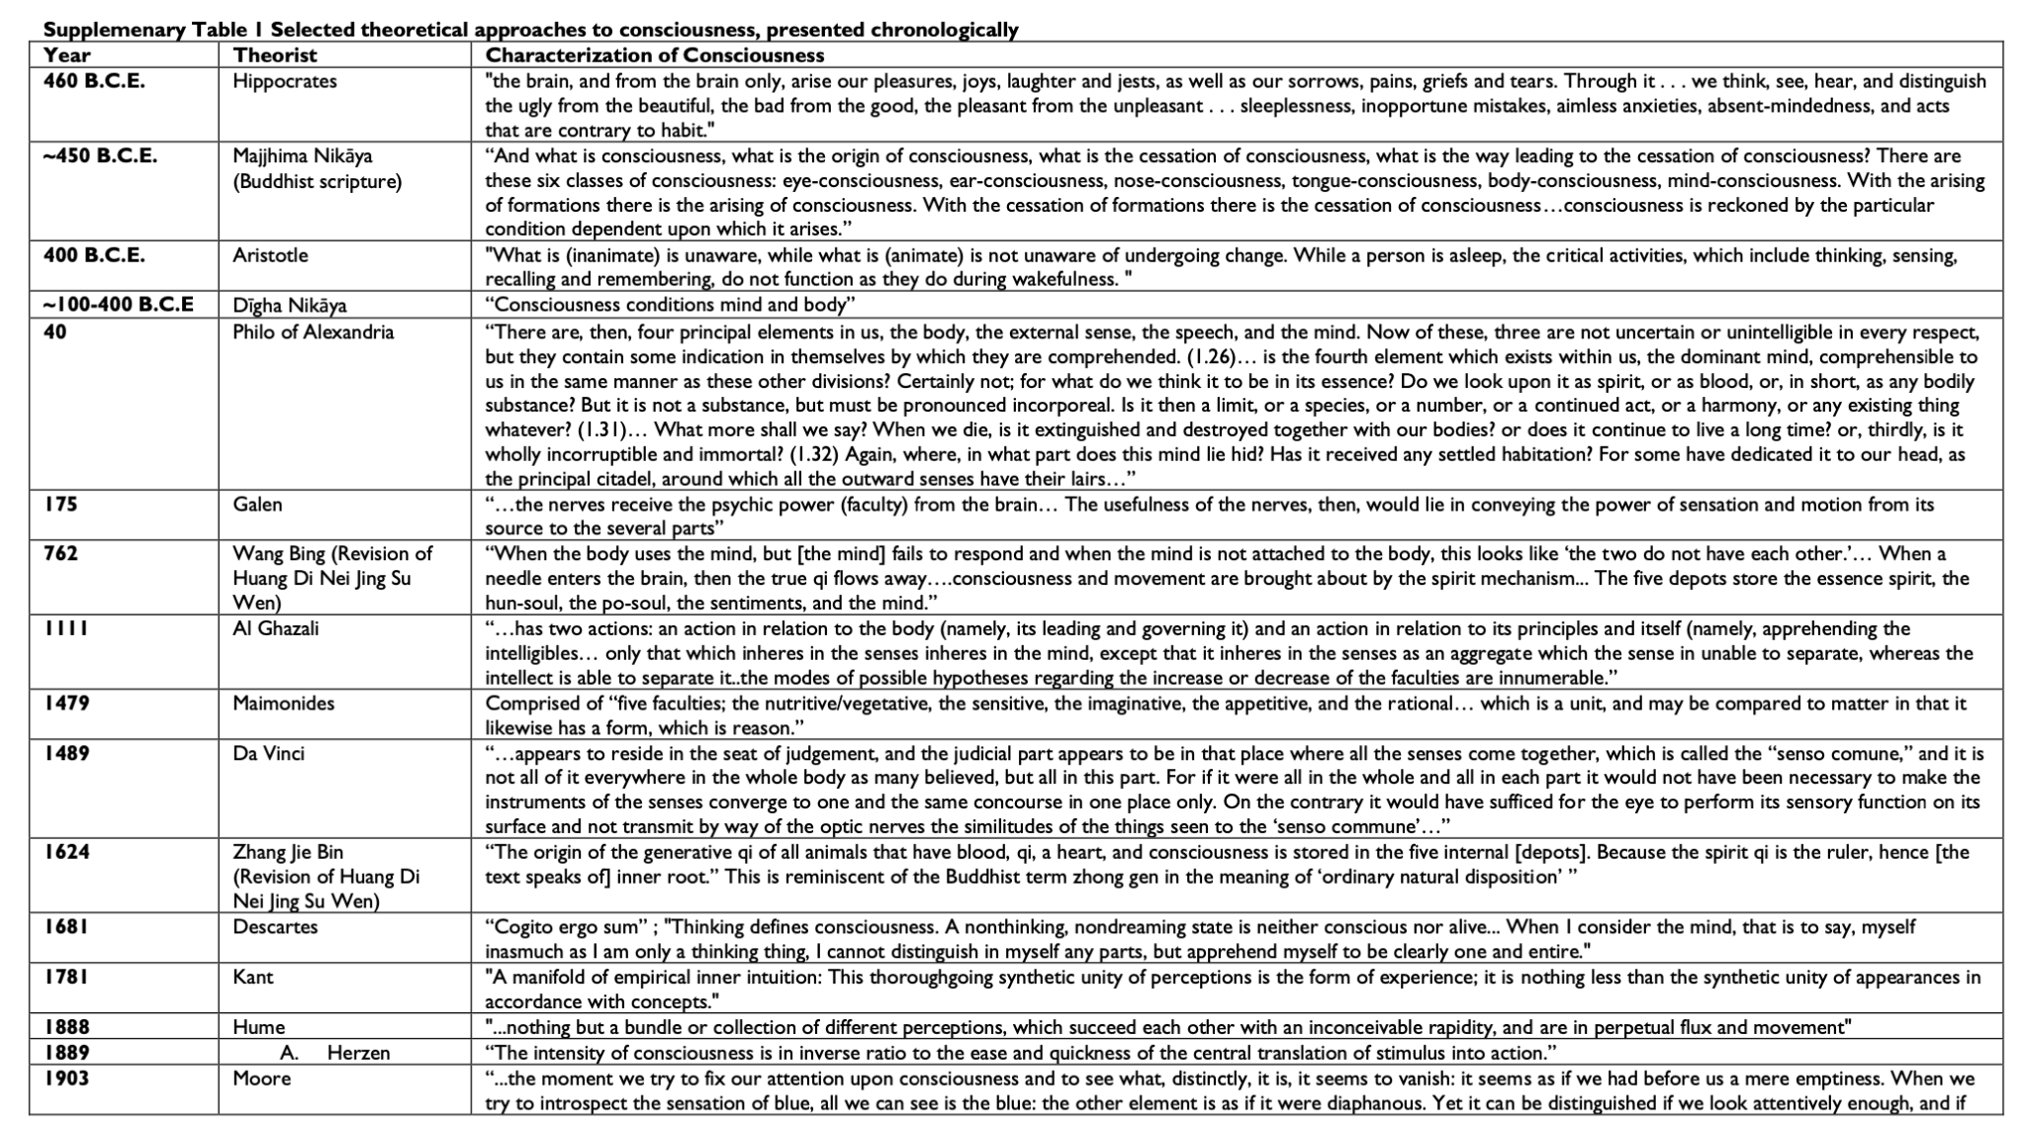
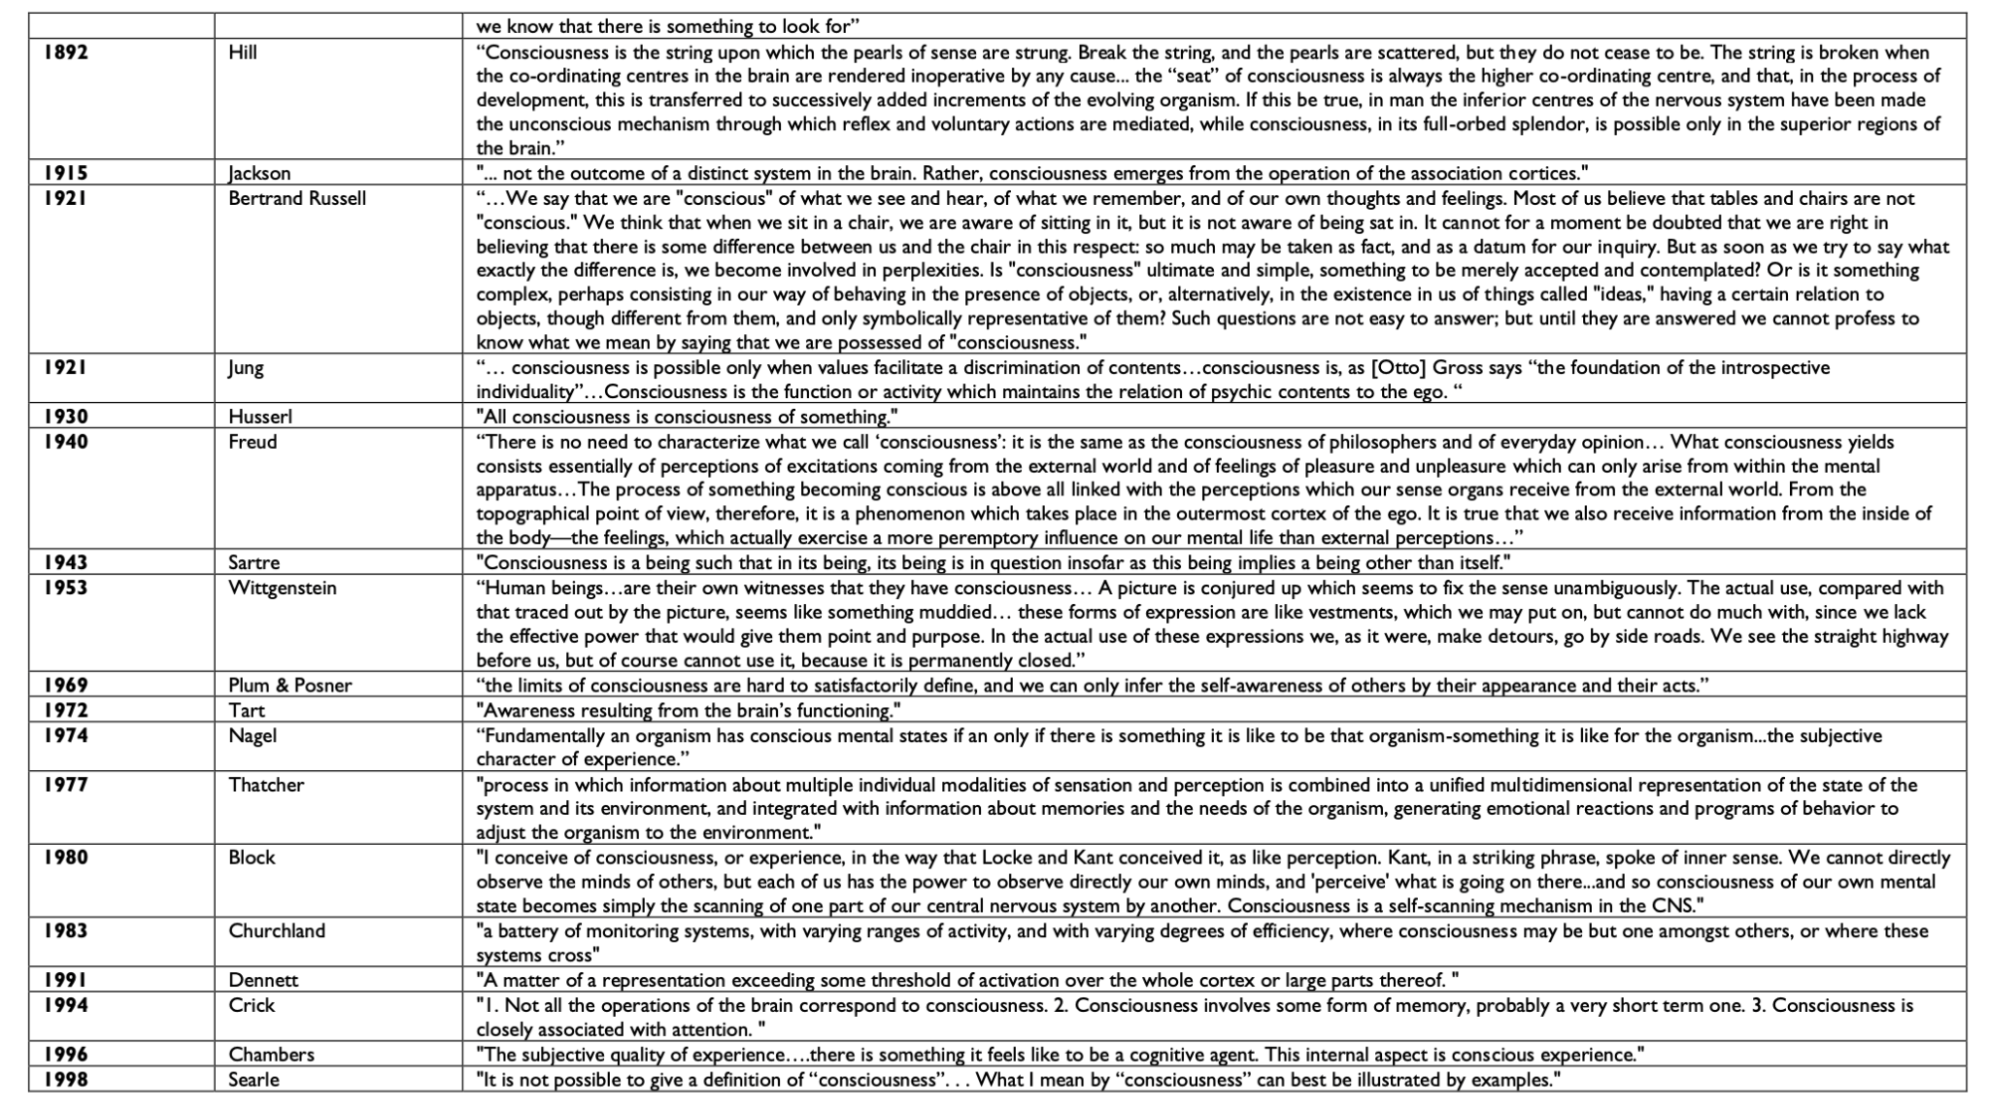
Notes:
In case you for any reason were uncertain about the breadth of philosophical views of consciousness, I’ve included this very ugly slide which contains three screenshots of their “Supplemenary Table 1 Selected theoretical approaches to consciousness, presented chronologically” , beginning with Hippocrates (460 BCE) and ending with Dahaene (2014). [And here, this could be an entirely different talk, but I’ll avoid that with a brief representation of a few ideas here).
I want to highlight a few:
[CLICK]
Majihima Nikaya
(Buddhist scripture), ~450BCE
“"And what is consciousness, what is the origin of consciousness, what is the cessation of consciousness, what is the way leading to the cessation of consciousness? There are these six classes of consciousness: eye-consciousness, ear-consciousness, nose-consciousness, tongue-consciousness, body-consciousness, mind-consciousness. With the arising of formations there is the arising of consciousness. With the cessation of formations there is the cessation of consciousness...consciousness is reckoned by the particular condition dependent upon which it arises.”
[CLICK]
Galen, 175
..the nerves receive the psychic power (faculty) from the brain... The usefulness of the nerves, then, would lie in conveying the power of sensation and motion from its source to the several parts"
[CLICK]
Maimonides, 1479
Comprised of "five faculties; the nutritive/vegetative, the sensitive, the imaginative, the appetitive, and the rational... which is a unit, and may be compared to matter in that it likewise has a form. which is reason."
[CLICK]
Husserl, 1930
"All consciousness is consciousness of something.”
[CLICK]
Searle, 1998
"It is not possible to give a definition of "consciousness"
.. What I mean by "consciousness" can best be illustrated by examples
Damasio, 1999
"The unified mental pattern that brings together the object and self."
So….complex definitions, some very hard to measure.

Slide 7
Bioethics and Neuroscience – or Neuroethics
“Questions of how to respect autonomy when the capacities that are prerequisite to autonomy are themselves disordered, as they are in DoC, are especially germane. This principle motivates inquiry into how to improve paradigms of consent, testing and counselling in this uniquely vulnerable and incapacitated population of patients.”
“…The principle of justice prompts further inquiry into topics surrounding stigma of persons with DoC, equity in access to neurorehabilitation, integration of disability rights perspectives and law, fair distribution of limited resources and disparities in care. (3292-3)
-Young, et al. The neuroethics of disorders of consciousness: A brief history of revolving ideas. Brain. 2021; 144:3291-3310. doi:10.1093/brain/awab290
Notes:
In addition to their ponderings of consciousness, and more to my point today, Young et. al also provide a useful conceptualization of how the bioethical principles of respect for autonomy, beneficence, non-maleficence, and justice emerge in questions of neuroprognostication, diagnosis, and communication with patients and families.
Beneficience and non-maleficience are relatively self-evident here, in the basic sense that we of course want to do the most good and the least harm possible. Respect for autonomy is complicated in some self-obvious ways, in that brain injury can inherently affect capacity to self-advocate, creating a “uniquely vulnerable and incapacitated population of patients,” and relying on surrogates to represent the patient’s values, goals, and beliefs in these circumstances also present particular challenges.
They also argue that, “…The principle of justice prompts further inquiry into topics surrounding stigma of persons with DoC, equity in access to neurorehabilitation, integration of disability rights perspectives and law, fair distribution of limited resources and disparities in care. (3292-3)
I particularly appreciate their attention here to justice concerns related to disability and equity, and I’ll want to tease those out a bit more as we continue.

Slide 8
Ethical challenges in DoC
undue pessimism/overgeneralization of nihilism
shortcomings in misdiagnosis
bias
Notes:
At any rate, Young et. al identify three significant areas of ethical challenges in DoC specifically, but that seem to work with neuroprognostication more broadly: nihilism, misdiagnoses, and bias. Undue pessimism or nihilism is the tendency to expect the worst possible outcome and potentially withdraw life sustaining treatment earlier than may be called for. They attribute an increase in this tendency to the emergence of the “right to die” movement and concerns about extended suffering. Additionally, data about recovering is complicated – it can seem to be better than expected, but may be biased as it may reflect outcomes for the healthiest of patients. In other words, we don’t see the outcomes of patients who transitioned to comfort care, for obvious reasons, though we can forget how that affects the data.
I’m not going to spend much more time on that, but I do want to look at elements of the other challenges

Slide 9
Salient classes … contributing to misdiagnosis in DoC
Patient factors
Sensory impairments
Motor/Praxis impairments
Fluctuating responsiveness
Comorbid conditions
Medications
Clinician factors
Evaluator inexperience/strain Confirmation bias Resource utilization bias
Systems factors
Complexity
Burden of proof
Training gap
|
“the absence
of
evidence
is not necessarily
evidence
of
absence”
Notes:
So, the second ethical challenge Young et. al identify is misdiagnosis, which perhaps could be better phrased as “complex diagnosis.” In part, this is where they dive into nerdy rhetorical definitional questions–and this is not irrelevant – consistency of language and definition for various levels of cognition is vital, but outside of my purview here. But these factors are not unfamiliar, I’m sure.
Patient factors
Sensory impairments
Motor/Praxis impairments
Fluctuating responsiveness
Comorbid conditions
Medications
Clinician factors
Evaluator inexperience/strain Confirmation bias Resource utilization bias
Systems factors
Complexity
Burden of proof
Training gap
Fischer et al also highlight some complexities of diagnosis of consciousness [CLICK]:
“The unresponsive wakefulness syndrome, which is thought to imply a lack of conscious awareness, is defined by the absence of behaviours that indicate consciousness, such as answering questions or following commands14–19. However, although the presence of such behaviours assures us that a patient is conscious, the absence of these behaviours does not necessarily indicate that a patient is unconscious (for example, blindness, aphasia or inattention might manifest similarly). That is, the absence of evidence is not necessarily evidence of absence. As such, categorizing patients in terms of their consciousness (or lack thereof) might imply more certainty about a patient’s consciousness than we actually have, which could mislead surrogates. “
Errors in diagnostics, and thus prognostics, clearly then are not only relevant to the clinical outcome, but are material to respecting autonomy and determinations of a patient’s values, beliefs, and goals of care
Now, I’d like to turn to spend more time on Young et al’s third are of ethical concern in disorders of consciousness, and for us, then neuroprognostication. They identify three biases of concern: self-fulfilling prophecy, disability paradox, and clarity about definitions of consciousness.

Slide 10
Biases: Self-Fulfilling Prophecy Bias
Notes:
Self-fulfilling prophecy is likely not a new concept, but I like Young et al’s definition: they claim it is a potentially performative act, creating the outcome that is being described as potential. They highlight here that the clinicians caring for patients with potential DoC (in critical care, or even just through the hospital course) don’t “bear witness to the clinical course of patient recovery during the neuro- rehabilitation phases, when care is directed by multidisciplinary teams including physiatrists, therapists and psychologists” (3299).
Bias emerges from patterns we see and understand, right? So this makes sense – and I’ve heard providers say this. Some of you see patients at particularly dire moments, and if you do see them again in the future, it’s often because of continued (or new) direness – you don’t tend to see what recoveries look like at later points. Others of you do have longer trajectories, staying with and following patients for significant periods of time. Both have pros and cons in terms of prognostication and understanding of outcomes, and bear the weight of the difference between statistics and lived experience (or lived experience alongside those living through this particular experience).
Mitigation of this bias can be somewhat controlled, in that this is an issue that will lie with providers–and we just need to remain aware of where our biases lie. (“just”, as though that’s easy, but it is at least within the system, perhaps?). Patients and families can also be subject to self-fulfiling prophecy biases, but that would be faced more in the negotiation of decisions than in prognostication itself.

Slide 11
Biases
devils and evil spirits
“Why do many people with serious and persistent disabilities report that they experience a good or excellent quality of life when to most external observers these people seem to live an undesirable daily existence?”
-Albrecht & Devlieger, 1999
holy punishment
medical model of disability
paradox
disability
“normal”
Disability reveals that our quality of life largely depends on caring and loving relationships - and is not reducible to how well our body systems function. The disability paradox shows us that physicians are not always able to imagine “good health” beyond the boundaries of medicine.
-Konerman-Sease, 2022
“natural”
Inspiration porn
hyper-independence
Ableism
inequity
The Broken Column
Frida Kahlo (1944)
Notes:
Bias number two – and, a good deal of time into this talk, the most significant area of interest for me: the disability paradox
The disability paradox can be defined as [CLICK] the misalignment between how people with disabilities consider their quality of life vs how people without disabilities perceive the quality of life of people with disabilities. (spoiler alert - people with disabilities perceive their quality of life higher than others). It is problem throughout society, but also distinctly in medicine, do to a combination of factors -
*historical beliefs about disability (including that it was a sign of possession by the devil or evil spirits, or punishment from god)
*the so-called “medical model” of disability, which views disabilities (and other differences or “abnormalities”) as things that require fixing
*conceptions of “normal” and “natural” shaped by unrealistic constructions of perfection (and influencing the idea that we should all fit particular norms)
*lack of positive, complex models of disability (that extend beyond “inspiration porn” and stories of “overcoming”)
*Enlightenment notions of independence, especially as codified in the US (and as opposed to interdependence, or godforbid dependence)
*historical and continued inequities in education, resources, transport, finances, and other access issues (and particularly the ways these inequities can be explained as caused by disability, masking that the structures themselves create disabilities – this gets us closer to the “social model” of disability, where it’s not the individual physical differences that are disabling (such as being in a wheelchair), it’s the constructions (like curbs and staircases) that are disabling))
The disability paradox is also a function of ableism–bias towards ability and against anything that does not present as ultimately abled. Konerman-Sease articulates another aspect of the disability paradox and bias towards independence over all else. She states, “Disability reveals that our quality of life largely depends on caring and loving relationships - and is not reducible to how well our body systems function. The disability paradox shows us that physicians are not always able to imagine “good health” beyond the boundaries of medicine.”

Slide 12
disability
“In our survey of 714 practicing US physicians nationwide, 82.4 percent reported that people with significant disability have worse quality of life than nondisabled people.”
-Iezzoni et. al, 2021
[Moral] Distress that arises from concerns about providing too much care at the end of life might be mitigated by exploring what role living with disability plays in our understanding of quality of life.
-Konerman-Sease, 2022
paradox
LAUREL LAWSON (TOP) IN 'DESCENT'. PHOTO BY JAY NEWMAN
Notes:
LAUREL LAWSON (TOP) IN 'DESCENT'. PHOTO BY JAY NEWMAN
https://www.danceinforma.com/2019/06/02/disability-arts-leader-laurel-lawson-is-dance-usa-artist-fellow/
We might be tempted to think, with “advancements in society” and such, that the disability paradox would not still be an issue today, but unfortunately, recent research suggests that it is still quite significant.
[CLICK] A 2021 article by Iezzoni et al studied how the “physicians perceptions of people with disabilities” might cause/affect the healthcare disparities faced by people with disabilities. The results were unsettling: “714 practicing US physicians nationwide,
82.4 percent reported that people with significant disability have worse quality of life than nondisabled people.
Only 40.7 percent of physicians were very confident about their ability to provide the same quality of care to patients with disability, just
56.5 percent strongly agreed that they welcomed patients with disability into their practices,
and 18.1 percent strongly agreed that the health care system often treats these patients unfairly. “
This can loop us back to the ethical concern of pessimism/nihilism in prognostication that Young et al describe–the disability paradox itself contributes to nihilism, as one’s sense of what “meaningful recovery” means would certainly be shaped by one’s sense of the connection between “meaningful” and “abled.”
[CLICK] Jaime Konerman-Sease ties the disability paradox to issues of moral distress, considering how our own understandings of what suffering means cause us legitimate distress when caring for, or even observing, patients with disabilities. Our senses of meaningful use of resources, or what aspects of treatment might be non-beneficial, are also shaped by what could be a fundamental misunderstanding of the meaningfulness of a disabled life.
These challenges extend beyond just neuroprognostication, of course, but they are particularly relevant here, as timelines for outcomes from neurologic injuries can extend from weeks to months to even years. Progress in healing and reaching a new baseline can be excruciatingly slow.
The disability paradox is further complicated because it can affect everyone – clearly not just practitioners. Patients and families carry their own perceptions of disability and suffering, and this clearly influences their decisions.
I want to come back to this – in considering shared decision-making and communication – but want to touch on Young et al’s third ethical concern first…

Slide 13
Body, psyche, and social life do change immediately following an occurrence of disease, accident, or injury, and medicine, public health, and bioethics all correctly appreciate the psychological and physical vulnerability of patients and their families and friends during immediate medical crises. These professionals fail people with disabilities, however, by concluding that because there may never be full physical recovery, there is never a regrouping of physical, cognitive, and psychological resources with which to participate in a rewarding life.
-Adrienne Ashe

Slide 14
Biases
[consciousness] is not a unitary state but rather a cluster concept that includes a number of interdigitated ingredients
clarity about the value of consciousness for patients and families
Notes:
The third concern of bias regards “clarity about the value of consciousness for patients and families.” For the authors, this ties into their thesis about clarity of terminology and conceptions of consciousness, with their helpful articulation of consciousness as “not a unitary state” but a cluster with “interdigitated ingredients” And then the multi-page overview of theories of consciousness. So, yes, a cluster, for sure.
But further, this clarity (or lack thereof) also remains tied to the disability paradox, as well as our presumptions of, or that, what we value will remain consistent in the face of significant change.
Relatedly, then, I want to add a fourth ethical concern for neuroprognostication – trauma itself.

Slide 15
How Should trauma Patients’ Informed Consent or Refusal Be Regarded in a Trauma Bay or Other Emergency Settings?
Suah & Angelos. AMA Journal of Ethics. 2018;20(5).
“In the setting of acute or traumatic injury, patient understanding is easily jeopardized by fear, anxiety, pain, medications, and physiological derangement, resulting in unreliable decision making. …However, in emergency situations, when there might be no available surrogate decision makers, the physician must act in a manner that will provide the maximum possible benefit and the best outcome for the patient.”
Notes:
A patient’s capacity for decision-making during trauma can be impacted by the elements of trauma itself – the emotional responses, pain and medication, as well as physiological problems. Again - probably completely obvious in the moment of trauma, and particularly if someone’s consciousness is altered. But how long does this persist?

Slide 16
Capacity and Trauma (Gerrek, 2018)
“Both Dax, directly, and Andrea, through her friends, expressed a wish to be allowed to die and, in both cases, this wish was not honored. Although Dax may in fact have had decision-making capacity when his requests to stop treatment were denied, Andrea’s case serves as a reminder that, for a severe burn patient, decision-making capacity and hence autonomous choice can be significantly compromised, both acutely and for some time after the injury is sustained…”
“Andrea maintains that she could not have made informed, autonomous decisions until weeks after the sedation was lifted.”
Notes:
You may be familiar with the famous burn patient named Dax Cowart (or not) – here’s the two-cent version: Dax was in a terrible car accident with severe burns as a teenager in 1973. During his recovery, he frequently begged to be allowed to die, and said that he did not want to live “as a blind and crippled person.” Years later, he became a lawyer and sued for wrongful life, and became an avid advocate for patient’s rights to die and against medical paternalism. Dax was THE story of burn recovery, particularly in ethics, for a long time.
In 2014, Andrea Rubin, a 49yo woman, was also in a car fire. She also suffered severe injuries, but was not conscious – she was sedated for about 2 months to promote healing. During that time, her friends advocated that Andrea would not want to live after this accident with her injuries, disabilities, and disfigurement. However, Andrea’s family were legal NOK and consented to treatment.
Andrea, still alive and well now, was very glad that the doctors did NOT listen to her friends, and to her own prior expressed wishes. Unlike Dax, her view, in retrospect, aligns with the disability paradox and the idea that we often cannot comprehend what we can and would find to be an acceptable life until we are living it. Between the sedation and injuries, and the shift in mentality, Andrea “maintains that she could not have made informed, autonomous decisions until weeks after the sedation was lifted.”
And again, as you heard if you attended Andrea’s bioethics @noon talk recently, this shift in mentality was significant and hard earned–

Slide 17
Capacity and Trauma
“...all patients thought informed consent was unrealistic at the time of their injury, but they believed that the capacity to give informed consent developed over time and coincided with improved function and understanding of their injuries”
Notes:
In her article, Monica Gerrek cites Brewster et al.s 2006 study in which patients were interviewed two to nine years after suffering flame injuries with a mean TBSA of 61%.
This prior research supports the claims Andrea herself made, and remains important to keep in mind for patients in any traumatic circumstances

Slide 18
Surrogates
The job of the surrogate to participate in decision-making on behalf of the patient
Decisions ought to be based on:
Stated wishes of patient: what they have said they wanted when capacitated
Substituted judgment: what we think they would have wanted based on values, goals, beliefs, etc.
Best interest: what would be in the patient's best interest in these particular circumstances based on their values, goals, etc, standard societal values (subjective), and medical judgment
If the surrogate is not making decisions consistent with one of these three methods, then the medical team may intervene.
Notes:
If we determine patients do lack capacity for certain medical decisions, then we must rely on surrogates, family, and/or friends to participate in medical decisions on the patient’s behalf, or even in coordination with the patient, to the extent that the patient can also participate (capacitated or not). So - again, not new information, but can be helpful to remember what the role of the surrogate is, and what standards ought to be used during participation
Again, though, surrogates themselves are subject to these biases, as well as to the stress of trauma – while perhaps not physically, surrogates are also facing sudden, unexpected, even incomprehensible changes for their loved one and themselves. The stress of being a surrogate can also be substantial, as the weight of representing what their loved one might have wanted, under circumstances that they may have never contemplated or discussed, with levels of medical complexity that surpass most non-medical people’s medical literacy – this situation is incredibly fraught.

Slide 19
Impacts of decisions on patients and families
Patients may experience:
the potential pain, suffering and loss of dignity of continued treatments that ultimately prove to be non-beneficial or without attainment of what the patient would agree to be a minimally acceptable neurological outcome.
Families of these patients may experience
significant financial losses and
psychosocial distress, and
Lack of resources and support systems for family members caring for loved ones
gaps in insurance coverage
exhausting of personal resources
substantial opportunity costs for family members
foregoing educational
Forgoing professional opportunities because of the need to care for, and be available for, a recovering loved one.
Notes:
Let’s throw another wrench in here–while we might contest outcomes influenced by the disability paradox, there are also real and significant challenges in decisions for treatment, therapy, and any sort of recovery, for the patient as well as for their family and friends.
First [CLICK], potential impacts for patients
And [CLICK] for families and loved ones
While at least several of these impacts are structural and societal (e.g. insurance coverage, cost and availability of good 24/7 care), the weight is borne by individuals. So, I can argue all day for structural change, but unless/until that happens, these are some of the realities patients and families face.
Disabilty paradox vs reality of resources
Disability visibility
New issues – until 1960s – we have the means
Reality vs painting an overly bleak picture
Interdependence
Moral distress
Decisions are FOREVER!!!!!

Slide 20
What do we do now?
Notes:
So – where are we?
We have biases, including issues of the disability paradox, as clinicians.
We have patients and families likely holding those same biases.
We have complex brain situations that may not have clear resolution for 3-24 months.
We have limitations of care and resources, financial and time, and the extensive support needed for recovery under any circumstances.
We have decisions that need to be made.
How do we negotiate all of this?

Slide 21
Awareness
Notes:
There are, of course, no easy answers. This is a bioethics talk – I hope you didn’t expect clear answers. And primarily, I’d like us to discuss what we think might lead to answers, or options.
But I’ll give you a few areas that might offer some direction.
The first is awareness – [CLICK] and this irritates me, as it feels potentially trite and empty. But we can’t confront our biases unless we become aware of our biases, so it is a legitimate space to start – just not the only action to be taken. Hopefully, developing awareness of biases (like ableism) will lead to some questioning of how we might embody those biases, and how that might affect our beliefs and behaviors, not only personally but professionally, in our medical settings. If we wish to mitigate maleficence, we have to consider how we might unknowingly be contributing to it.

Slide 22
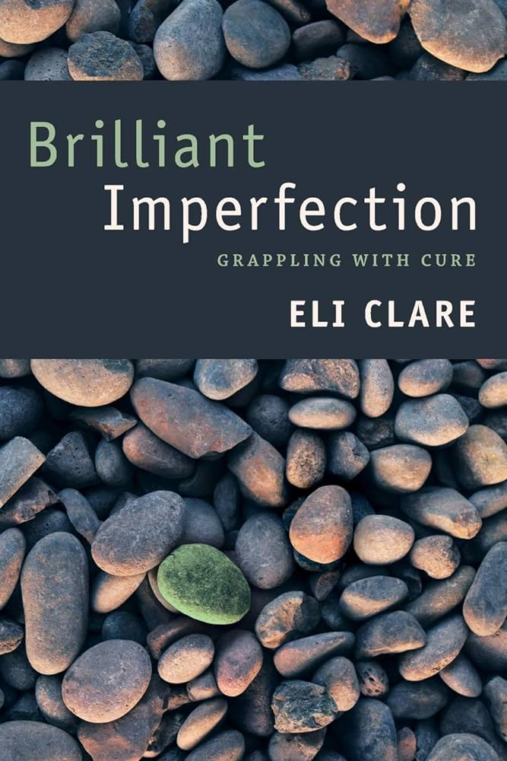
Education
https://disabilityvisibilityproject.com/
Notes:
Another is education – we have to learn more, we have to teach more, both as individuals and in our respective fields. How do we combat the disability paradox? By listening to people with disabilities. By hearing/reading/seeking out more voices, and blasting the singular narrative of ablelism. Disability Visibility is one place to start – a great book of essays. Eli Clare’s Brilliant Imperfection: Grappling with Cure is another – a beautiful collection of prose, history, theory, and poetry of Clare reflecting on their own experience with disability and the concept (and practice) of “cure.”
Alice Wong, editor of Disability Visibility, is an outstanding disability advocate, with Disablity Visibility Project as one of her major projects–I’ve added the web address to this screenshot of the websites landing page
Rosemarie Garland-Thomson, an esteemed scholar of english, bioethics, and disabilty, argues for specific education in what she calls “disability cultural competence” in her 2017 article in the Kennedy Institute of Ethics Journal titled “Disability Bioethics: From Theory to Practice.” This article is her argument for an operationalization of disability theory that could be brought into study in med school, residencies, bioethics, nursing, and other related fields.
She writes, “Disability cultural competence involves five interconnected elements: 1) biomedical decision-making, 2) disability culture and history, 3) accessible technology and design, 4) disability legislation and social justice, and 5) disability cultural competence research.”
This is just a smattering – but we have to reach for knowledge beyond the inspiration porn news stories focused on overcoming. Seeing a paralyzed person “walk” with an expensive exoskeleton is pretty neat, but it is not the goal or desire of all people with paralysis.
These could potentially be kinds of resources offered to patients and families for their education, but mid-trauma might not be the right time. What might be helpful, though, would be integration of advocates like Andrea for burn patients – patients and families who have made different choices in similar circumstances who could be available to answer questions for patients and families facing these decisions.

Slide 23
Communication
“Such counselling should aim to explain the range of best and worst possible interpretations and outcomes, instead of relying on synthetic or mono- tonic judgments, avoid disability bias and ensure that care delivered protects patient dignity and preferences to the extent that they may be ascertained” (Young et al, 3299)
“To guide clinical decisions, the anticipated recovery trajectory must be contextualized by the patient’s goals of care; that is, what the patient hopes to achieve with medical intervention. For the purpose of neuroprognostication, where the ‘care’ in question is often LST, the goal of care can be defined as the minimum level of neurological function that would make life worth living for the patient. …Goals of care also include a second component: a deadline for achieving the minimum level of neurological function that would make life worth living. Many patients are not willing to wait indefinitely in a rehabilitation or long-term care facility to attain their goals, and thus the deadline estimates how long the patient would probably be willing to wait to obtain this minimum level of neurological function” (Fischer et. al).
Notes:
The last incredibly broad area is communication – and here I’m thinking most specifically of how we communicate with families about neuroprognostication, potential outcomes, and decisions, in such a way as to promote justice (equity, access, anti-bias) and respect autonomy, through eliciting complicated perspectives of the patient’s wishes, values, and goals.
Young et al offer a perspective of what counseling with patients and families should achieve – good goals, but not very explicit. Fischer et al, however, do provide what to me was a useful 2-part articulation of goals of care. Their whole article in fact is a heuristic for neuroprognostication that is pretty interesting, including some formulas and math (while also acknowledging that neuroprognostication can’t be reduced to numbers). They include a table (2.1) with some sample language…

Slide 26
Thank You
Notes:
So - that’s a smattering of ideas. I’d like to have a stronger take-away than a smattering, but my basic purpose here is this:
Neuroprognostication is challenging, as is other prognostication, but also in ways particular to these injuries
Consciousness is complicated
Bias, particularly in relation to the disability paradox, adds further complications for providers, patients, and families
There is no singularly correct ethical choice here, but I think an ethical path through must include recognizing and questioning our own biases; helping patients and families navigate through their own values and goals and (gently) biases; being transparent about what complications may emerge in any path forward;

Slide 27
References
Albrecht GL & Devlieger PJ. The disability paradox: High quality of life against all odds. Soc Sci Med. 1999 Apr;48(8):977-88. doi: 10.1016/s0277-9536(98)00411-0.
Fischer D, Edlow BL, Giacino JT, Greer DM. Neuroprognostication: a conceptual framework. Nat Rev Neurol. 2022 Jul;18(7):419-427. doi: 10.1038/s41582-022-00644-7. Epub 2022 Mar 29. PMID: 35352033; PMCID: PMC9326772.
Iezzoni LI., et al. Physicians’ perceptions of people with disability and their health care. Health Affairs. 2021;40(2). doi: 10.1377/hlthaff.2020.01452
Gerrek ML. Getting Past Dax. AMA Journal of Ethics. 2018;20(6):581-588. doi:10.1001/journalofethics.2018.20.6.mhst1-1806
Konerman-Sease J. Moral distress and the disability paradox. UMinn Center for Bioethics. 2022, Mar 21. https://bioethics.umn.edu/news/moral-distress-and-disability-paradox#:~:text=The%20disability%20paradox%20reveals%20that,everything%20is%20in%20working%20order.
Suah A, Angelos P. How Should Trauma Patients’ Informed Consent or Refusal Be Regarded in a Trauma Bay or Other Emergency Settings? AMA Journal of Ethics. 2018;20(5):425-430. doi:10.1001/journalofethics.2018.20.5.ecas1-1805
Young, et al. The neuroethics of disorders of consciousness: A brief history of revolving ideas. Brain. 2021; 144:3291-3310. doi:10.1093/brain/awab290

Slide 28
References
IMAGES
10 Principles of Disability Justice; from Sins Invalid. https://www.sinsinvalid.org/blog/10-principles-of-disability-justice
Consciousness image; from Graziano, M. (18 Sept 2019). True nature of consciousness: Solving the biggest mystery of your mind. New Scientist. https://www.newscientist.com/article/mg24332480-000-true-nature-of-consciousness-solving-the-biggest-mystery-of-your-mind/
Prophecy image: License details: Creator: Picture processing Lars Henriksson,www.avrosys.nu

Slide 29
Equal Treatment of Persons with Disabilities
“Crucially, the United Nations Convention on the Rights of Persons with Disabilities (CRPD) and Americans with Disabilities Act (ADA) mandate equal treatment of persons with disabilities and prohibits discrimination in the provision of services on the basis of disability.141,243,244 Specifically, CRPD Article 25 stipulates that ‘persons with disabilities have the right to the enjoyment of the highest attainable standard of health without discrimination on the basis of disability . . . including health-related rehabilitation . . . early identification and intervention as appropriate, and services designed to minimize and prevent further disabilities’.” (Young, et al, p.3301)

